Slide 1
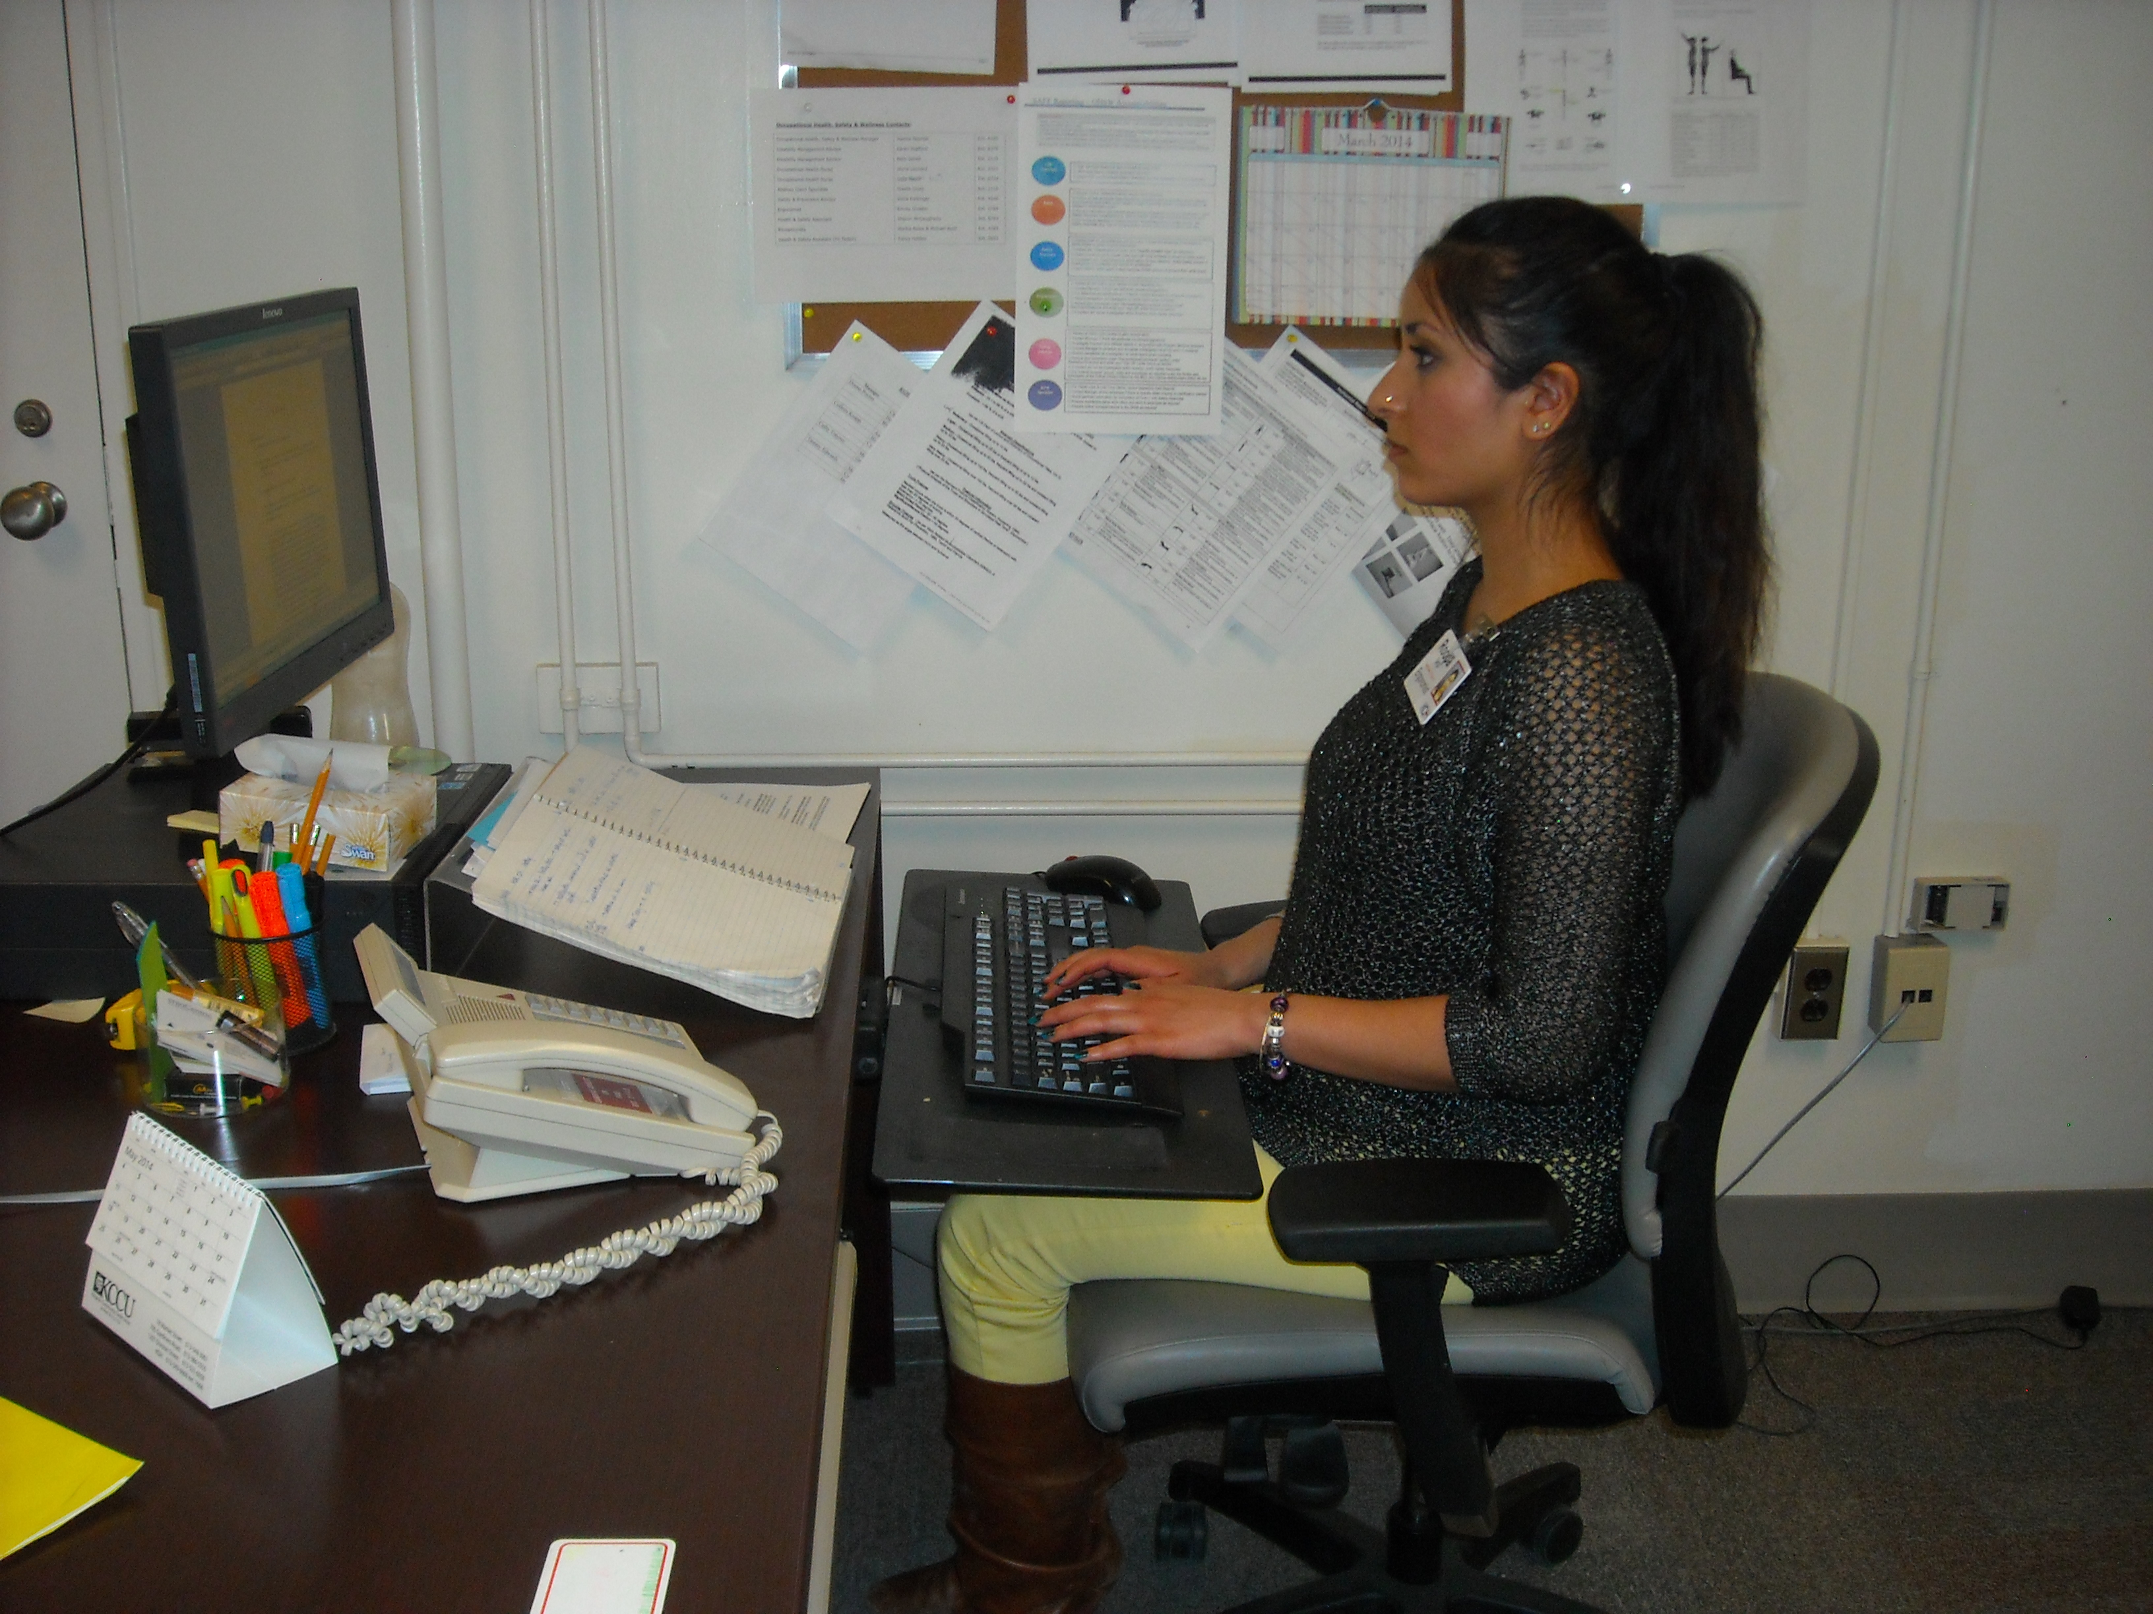
Health & Safety Training
for Non-Clinical Students

Slide 2
Introduction
This presentation is designed for students working in non-clinical areas who are on placement at KGH as part of their learning experience.
It will provide you with information to facilitate a safe learning experience and will ensure you have the right information to respond to safety and emergency related situations.
Remember… working safely is essential to protecting your own well-being
as well as that of your peers, other staff, our patients, and visitors.

Slide 3
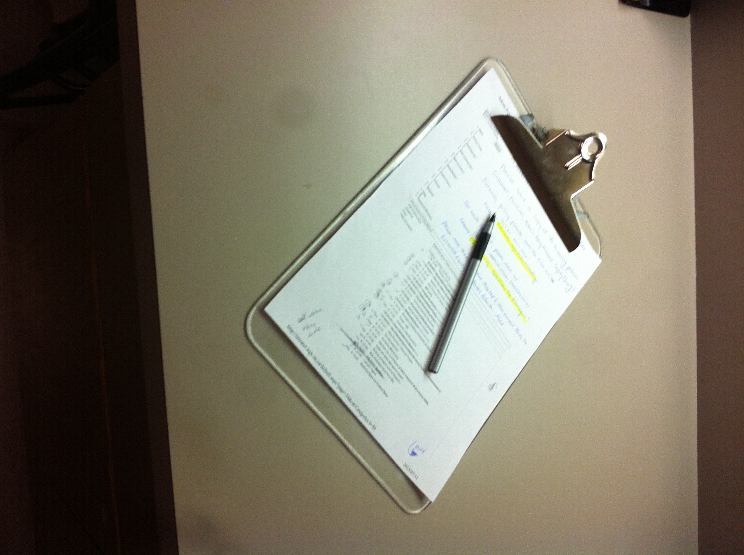
Introduction
If you do have any questions with regard to your health & safety while at KGH talk to:
Your Clinical Instructor or the individual who is supervising your practicum
Your Educational Institution
KGH’s Joint Health & Safety Committee
(JHSC rep contact info is available on H&S Boards)
the KGH Occupational Health, Safety & Wellness Department located on Armstrong 1

Slide 4

Learning Objectives
At the end of this module, you will have an increased awareness of:
Key Health and Safety Policies and safe practices to be followed at KGH
Hazards you may encounter at KGH and the safety precautions you must follow to protect yourself
First aid, hazard, and injury reporting procedures in the event you sustain an injury at KGH
Infection prevention & control practices that are important in our health care environment including what do if you are ill with potentially infectious symptoms.

Slide 5
Learning Objectives
At the end of this module, you will have an increased awareness of:
KGH’s workplace violence prevention program
Where you can access KGH’s Safety Data Sheets for chemicals used in our hospital
Emergency Response protocols including Fire Safety
This training module does not cover worker rights and responsibilities which are addressed under
Health & Safety Awareness Training for Ontario Workers
Which is provided to students by their schools.

Slide 6
Health & Safety Policies
All of KGH’s corporate health & safety policies are located within the hospital’s Administrative Policy Manual which is accessible online from the KGH intranet. The unit/dept where you are placed, may have additional policies you may need to be aware of.
Employers in Ontario are required to have a Health and Safety Policy that is posted in the workplace. At KGH our Health & Safety Policy (#02-098) is posted on the KGH intranet as well on a number of health & safety boards that are throughout the organization.
The corporate Health & Safety Policy (#02-098) outlines our commitment to worker safety. “KGH will take every reasonable precaution for the protection of workers. Health and safety efforts will focus on eliminating and/or reducing known or foreseen threats to human health and the environment through the implementation of hazard control measures. Even in the face of uncertainty, precautionary measures will be taken to ensure the protection of our staff.”

Slide 7



Common Hazards in Health Care
At KGH, policies and procedures are in place to protect individuals from hazards that exist in our environment.
As student working in non-clinical areas, the hazards you may be exposed to may include for example:
  Chemical hazards (Cleaning Agents, Scents)
  Slip/Trip/Fall hazards (Electrical cords, spills,
  uneven surfaces, debris, equipment)
  Ergonomic hazards
  Physical Hazards (musculoskeletal injuries from patient transfers)
  Fire Hazards (Emergency exits obstructed,
  combustible items stored close to sources of
  ignition, self-closing doors propped open, etc.)

Slide 8
Key Health & Safety Policies
As a student at KGH, it is important for you to be aware of some key health & safety
policies that apply to all those working or volunteering at KGH.
You should be aware of the policies outlined in this presentation, including:
Safe Footwear Policy #02-099
Scent Free Environment #02-201
Hazardous Materials (WHMIS) #02-090
Emergency Eyewash & Shower Stations #02-102
Reporting & Investigation of Employee/Affiliate Events/Injuries #02-096
Workplace Violence Prevention #02-143
Hospital Identification #02-010
Management of Staff with Febrile or Potentially Infectious Illness #02-200
Musculoskeletal Injury Prevention #02-084 (additional training module to be provided)
All corporate health & safety policies are located within the hospital’s Administrative
Policy Manual which is accessible online from the KGH intranet.

Slide 9




Safe Footwear Policy
For those students working in non-clinical non- food handling areas and office spaces, footwear
must have:
      -Adequate support
      -Be in good repair / sturdy
      -Maximum heel height of 2½”
  Flip flops are NOT permitted anywhere on the premises

Slide 10
Scent Free Policy
In an effort to provide a healthy and safe environment for our patients, staff, learners, volunteers, and visitors, KGH has instituted a scent free policy.
If you are coming to KGH to work, learn, or volunteer, please be sure you are in compliance with the hospital's scent free policy which includes:
Refraining from wearing cologne, perfume, scented personal care products such as body lotions, sprays, and powders, scented deodorant and hair care products, and aftershave lotions.
Avoiding bringing in scented flowers including but not limited to: Freesias, Lilacs, Lavenders, Lilies (including day/tiger/Easter, lily of the valley and star gazers), Hyacinth and Peonies.
Refraining from bringing scented air fresheners or personal hand lotions from home. Fragrance – free hand lotions are available at the hospital.

Slide 11
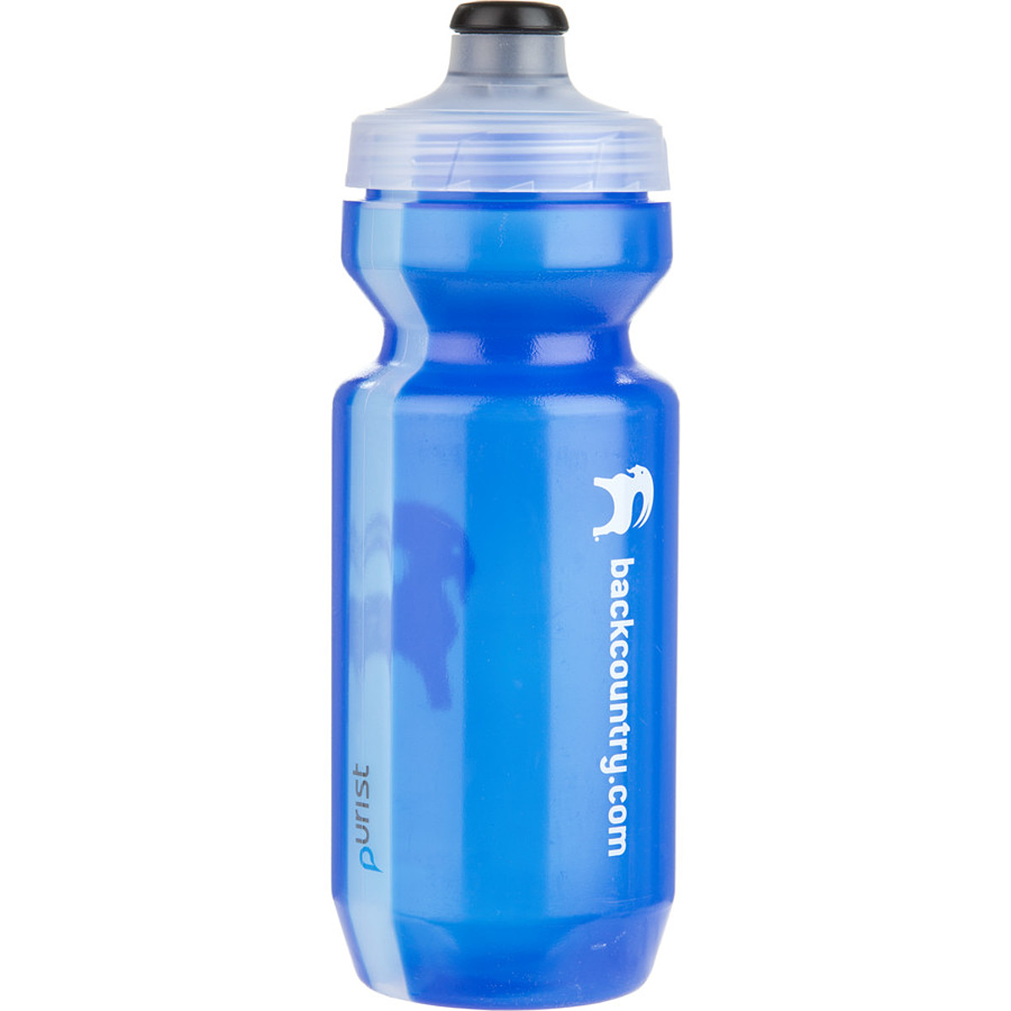
Food and Drink Policy
Where infectious materials (e.g. blood/body fluids), hazardous chemicals, or hazardous drugs are used, handled, or stored
NO FOOD OR DRINK can be stored or consumed by staff.
Areas where Food & Drink are not permitted include:
Areas where specimens are stored
Direct patient care areas including patient rooms, patient exam rooms, procedure and treatment rooms, and patient care corridors
Areas where chemicals and/or medications are stored including Laboratories, Pharmacy, Central Processing, Housekeeping Areas (closets), Maintenance areas
On or in mobile equipment (e.g. medication, isolation and supply,
housekeeping, and maintenance carts)
Areas containing contaminated equipment/materials (dirty utility room)
Patient supply storage areas (clean utility room).

Slide 12
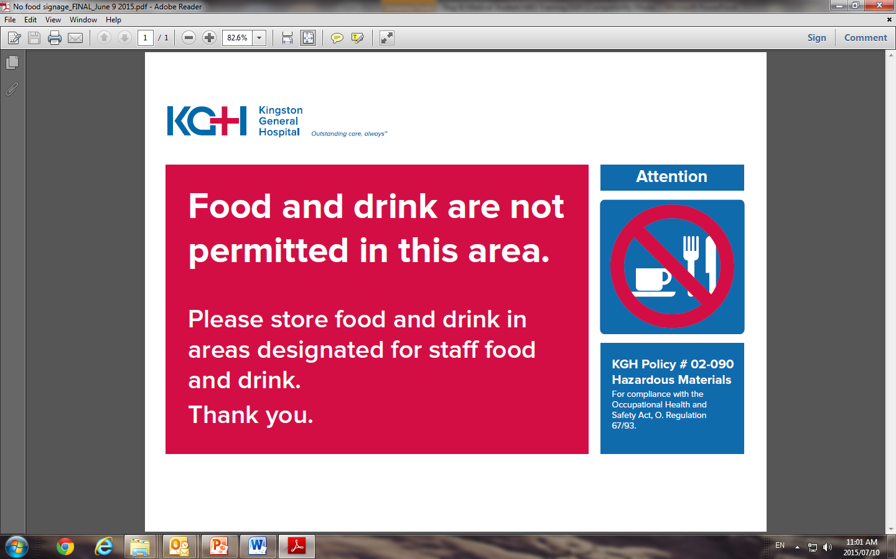
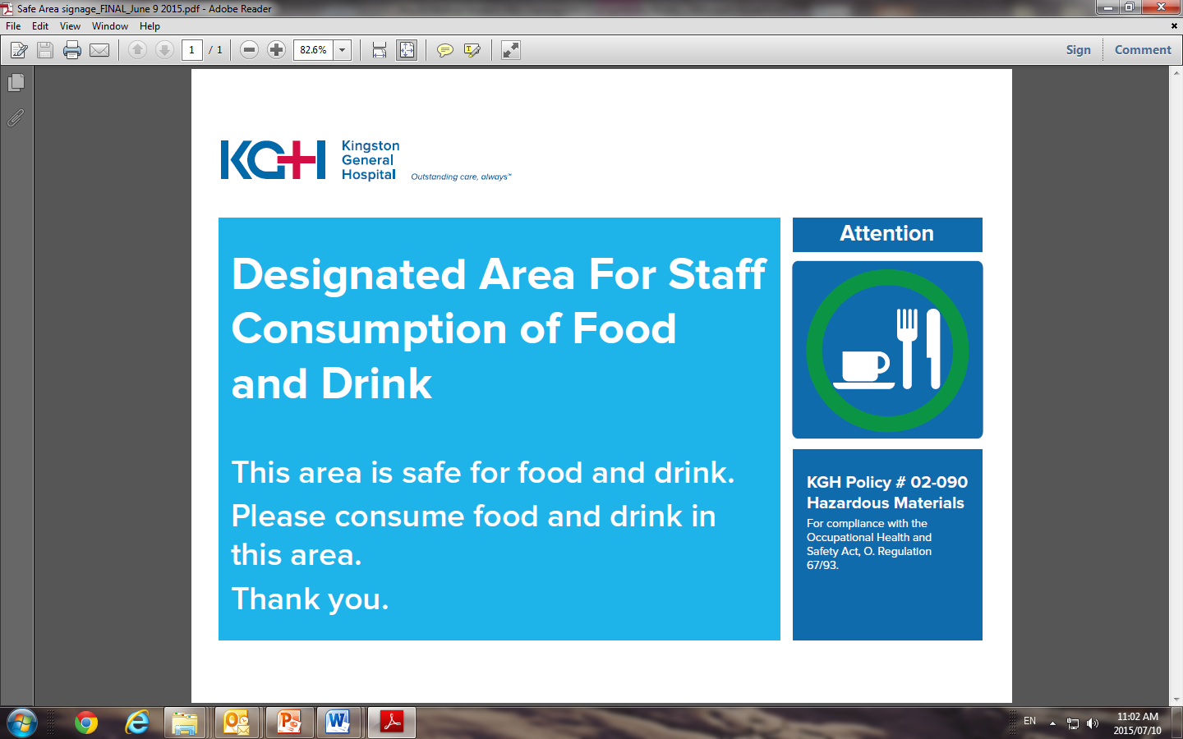
Food and Drink Policy
Each unit/department has identified areas of potential contamination where food and drink is prohibited and designated areas where food and drink can be safely stored and consumed by staff.
Watch for signage in your work area that tells you what area(s) have been designated as “safe” for food and drink for staff.
If no signage exists, ask the individual in charge.

Slide 13
Hazardous Materials (WHMIS)
All chemicals/hazardous materials used at KGH must be accompanied by a Safety Data Sheet (formerly called a Material Safety Data Sheet- MSDS).
Safety data sheets provide important safety information including the hazards of the chemical, safety precautions to follow, and measures to take in the event of accidental contact with the chemical.
At KGH, we have an online database where we maintain our safety data sheets.
The database is accessible to everyone at KGH from the KGH intranet homepage as a quick link allowing easy access to the data sheet.

Slide 14

MSDS Database Link
You can access the database directly from the KGH Homepage under the “Quick Links” on the left of the screen by clicking on Material Safety Data Sheets

Slide 15
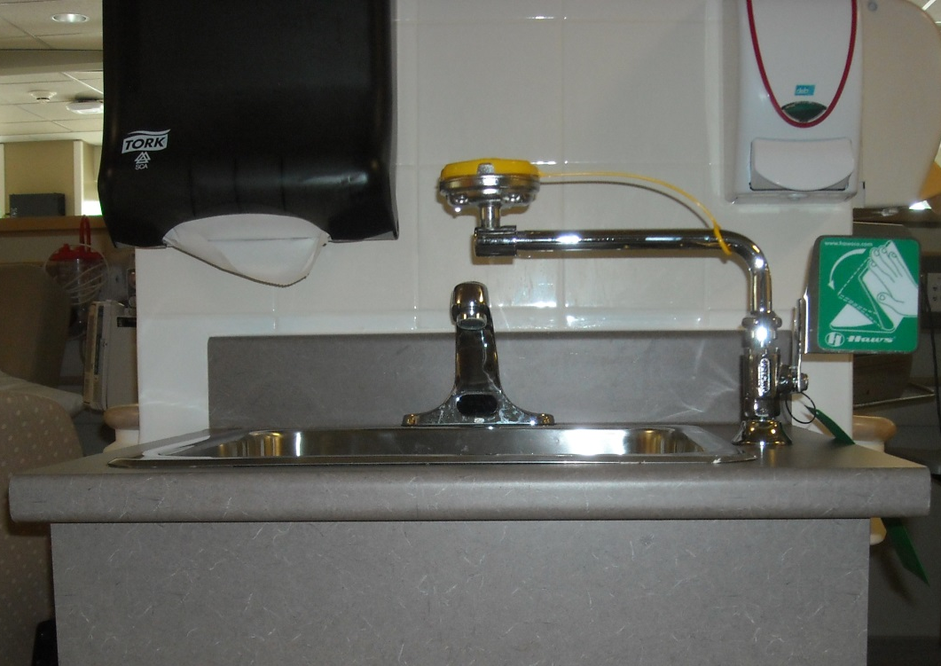
Chemical Exposure
In the event you are exposed to a hazardous chemical, visit the closest eyewash station and:
Immediately flush the injury site with running water for 15 minutes.
Exposed eyes, nose, or mouth should be thoroughly flushed with running water at an emergency eyewash station for 15 minutes.
Thoroughly rinse non-intact skin
Visit one of the hospital’s first aid stations or the Occupational Health Department should you require first aid.

Slide 16
Chemical Exposure
Visit the hospital’s Occupational Health Safety & Wellness Department in Armstrong 1 (or the KGH Emergency Department if after hours), if you require assistance for post injury/post-exposure assessment. They will provide first aid and evaluate the significance of your exposure to determine if further medical treatment is needed.
Report the incident to the most responsible person at the hospital (e.g. supervisor of unit/dept.) and your school (e.g. clinical instructor)

Slide 17
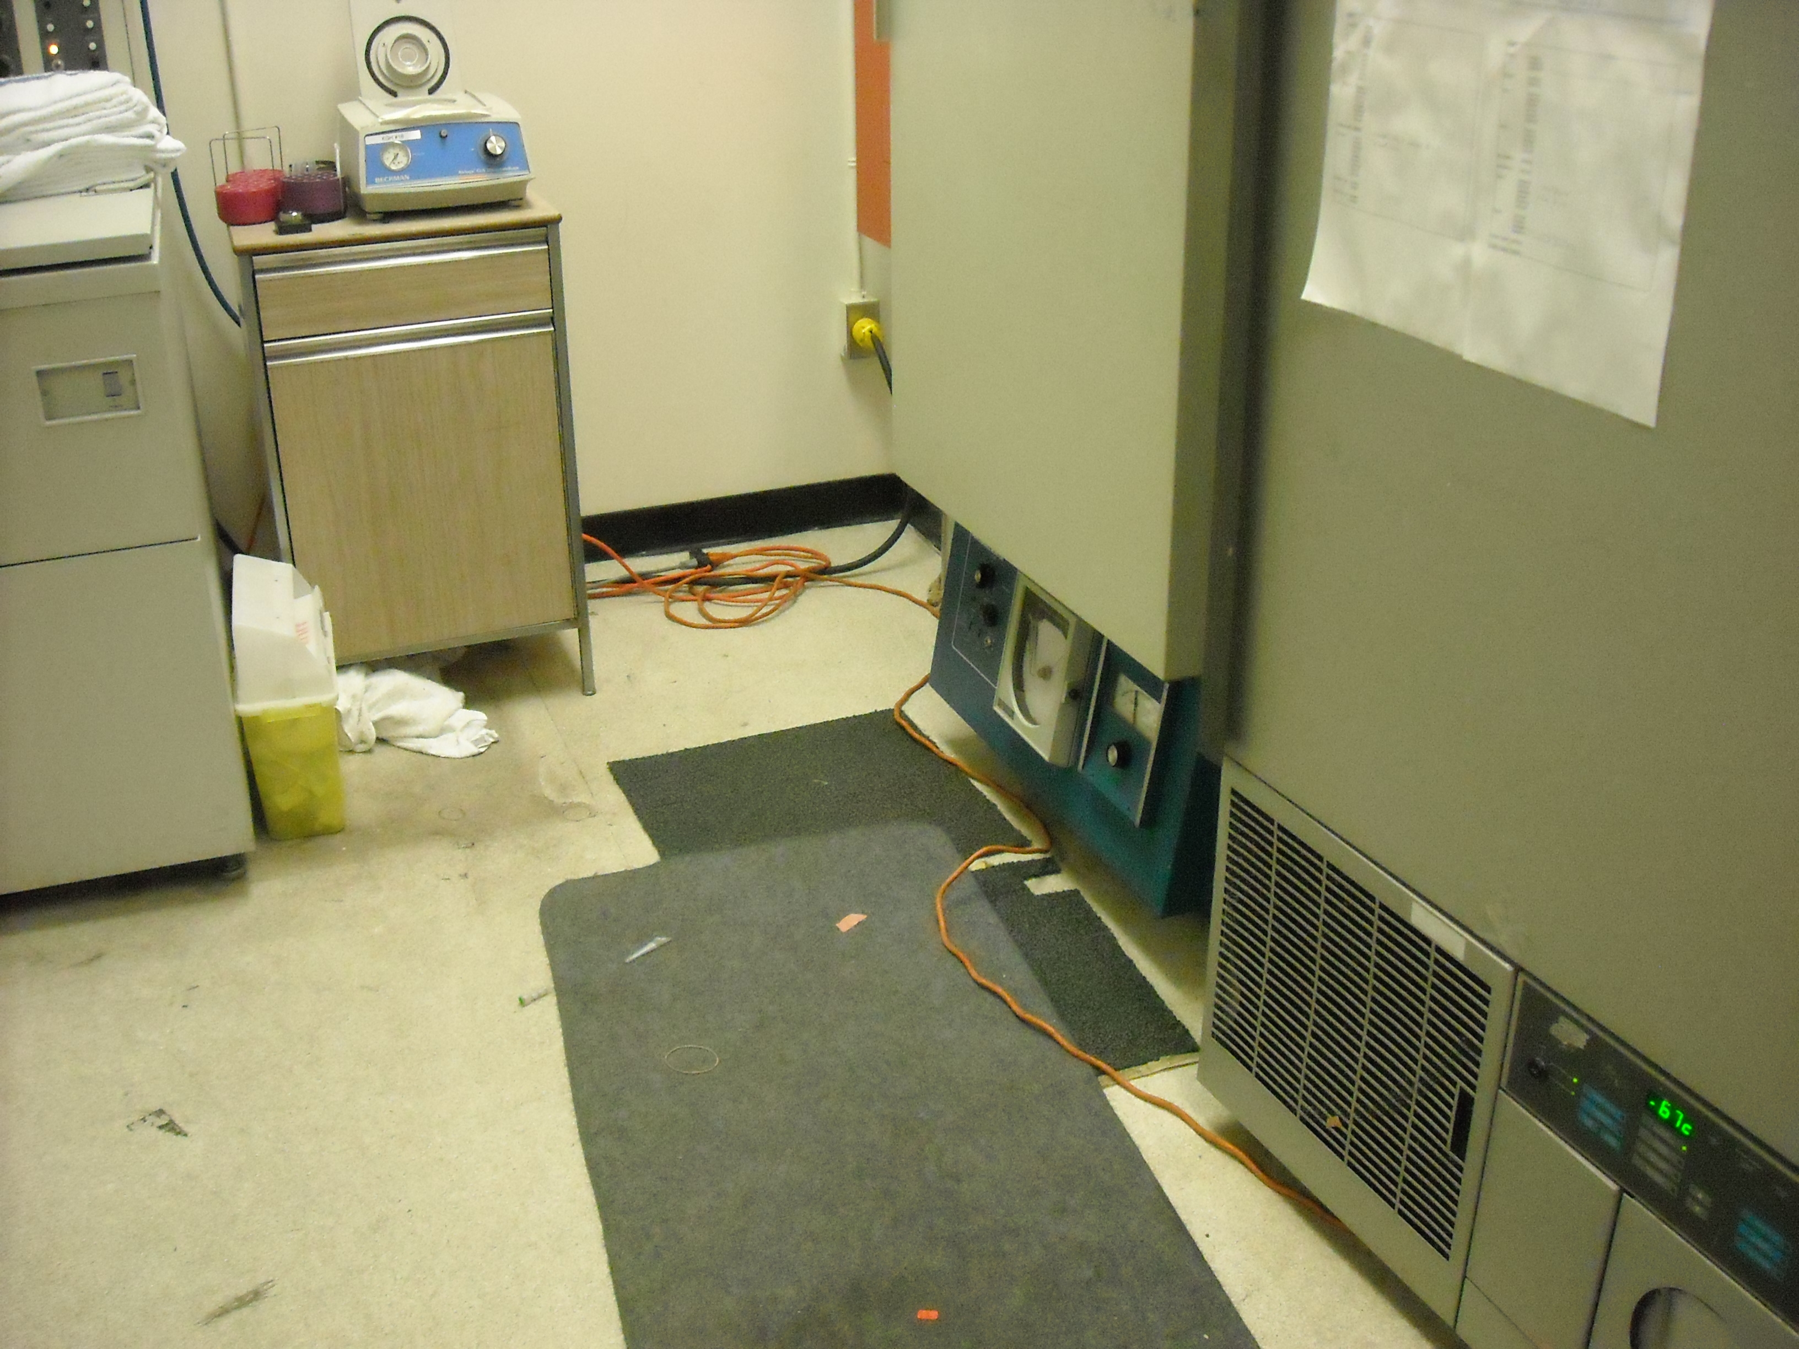
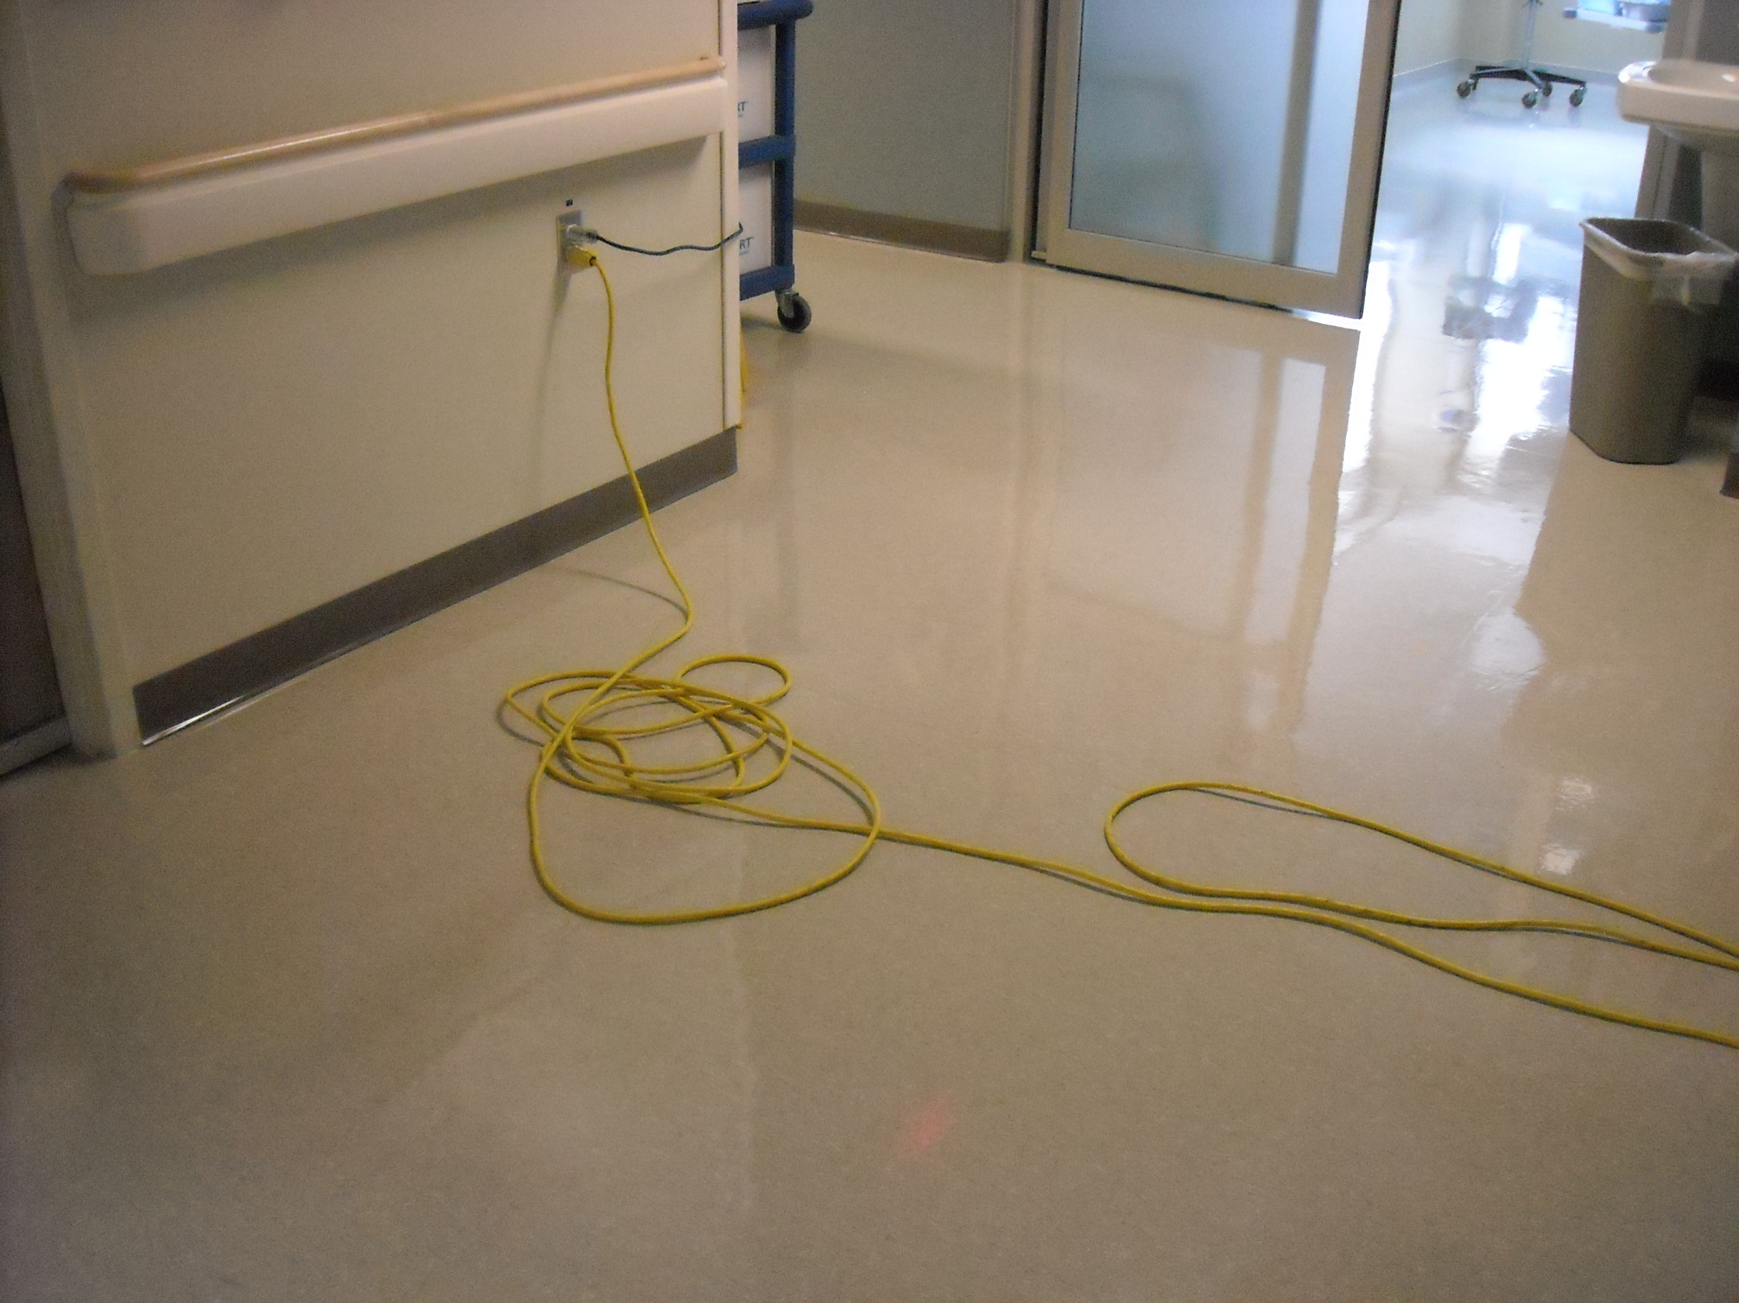
Preventing Slips/Trips/Falls
Slips, trips, and falls can occur for a number of reasons in our environment:
  Spilled liquids
  Power/extension cords
  Items not stored safely/clutter
  Working at heights with inappropriate equipment
  Inappropriate footwear
  Uneven floor surface
  Rushing, distracted/not paying attention

Slide 18
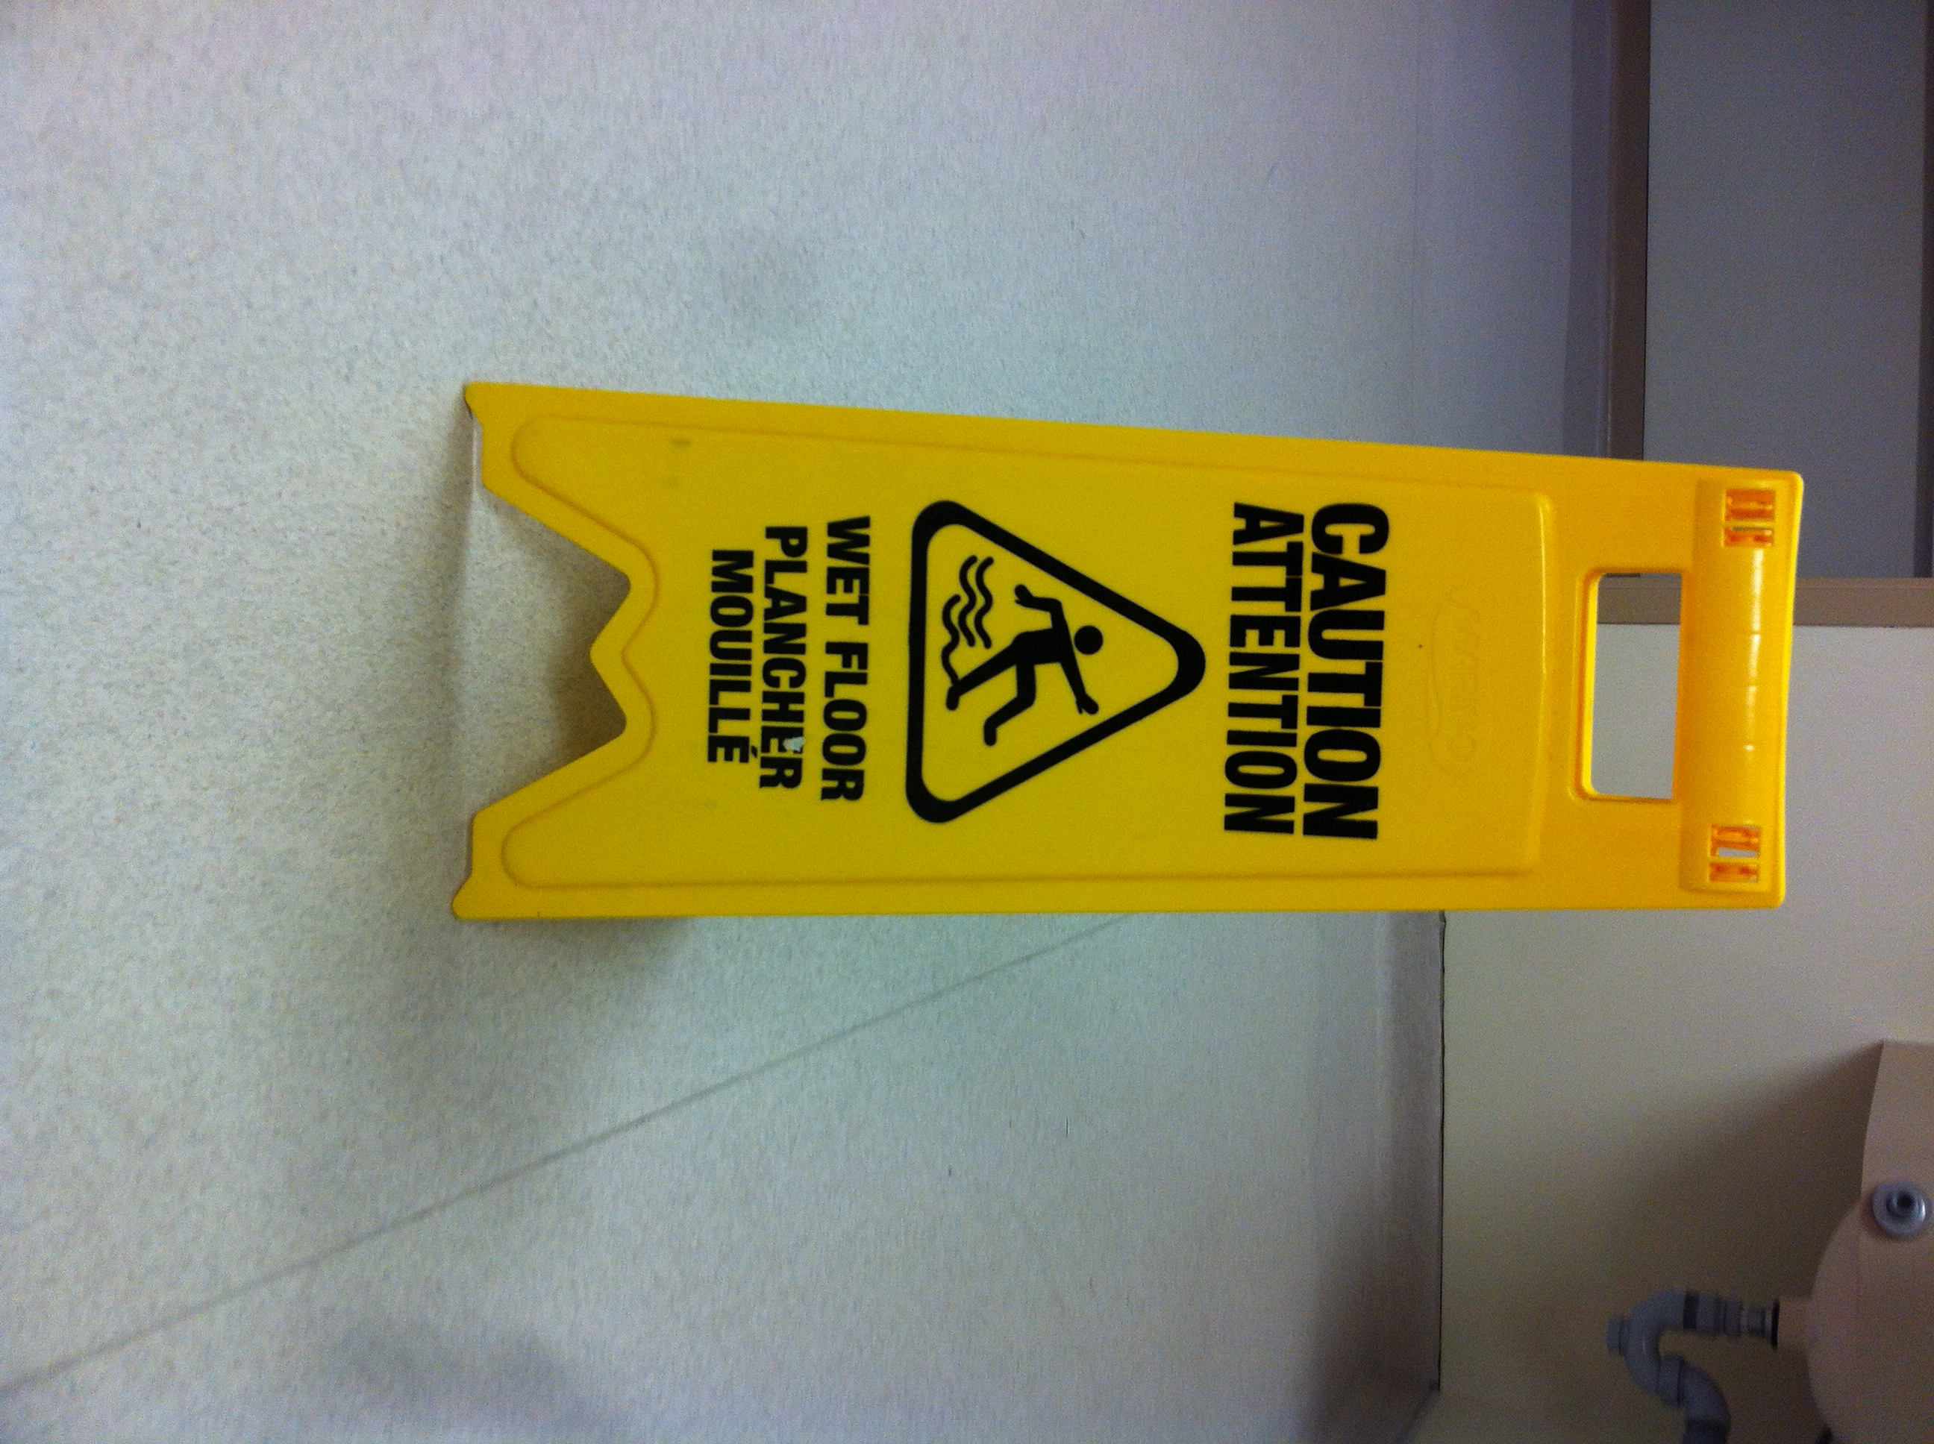
Preventing Slips/Trips/Falls
To prevent falls, we expect all those working on site to take appropriate precautionary measures to prevent falls. These include:
Slow down; do not run; pay attention;
Avoid texting/use of smart phones when walking in the hospital
Wear appropriate footwear for your job and ensure footwear meets KGH’s Footwear Policy
If you spill or come upon a spill of water or coffee, immediately put up a wet floor sign and obtain paper towel to clean up. For larger spills, contact Environmental Services.
Organize cords and other equipment so that
it does not create a hazard to others.
When coming in from outdoors use mats to dry footwear
Keep your eyes open for hazards and promptly report them to your on site supervisor

Slide 19
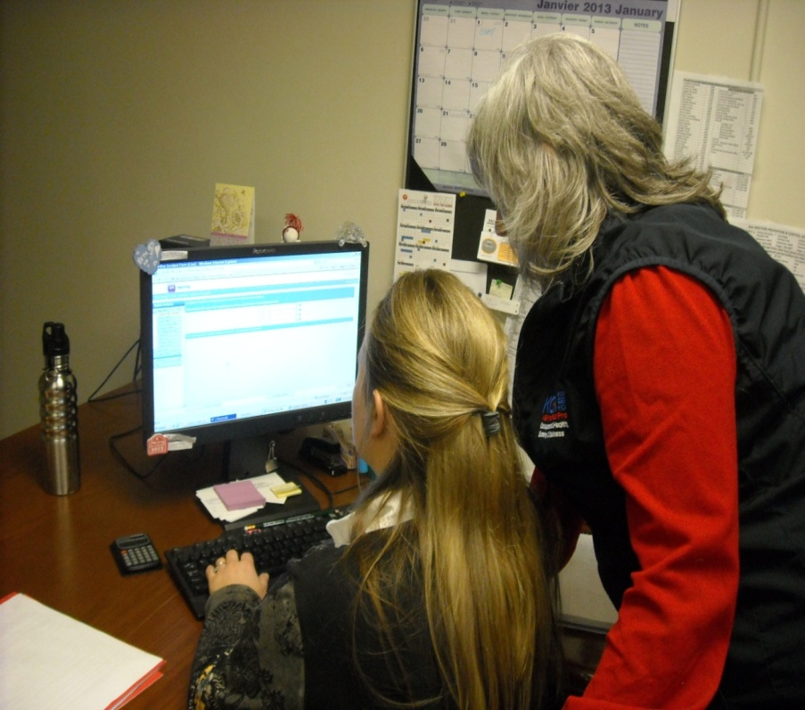
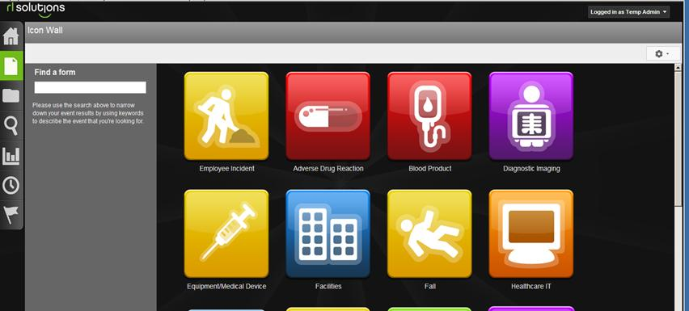
Reporting Incidents/Injuries
Reporting near misses, incidents, and injuries
is encouraged at KGH as it helps to:
  identify what went wrong and why;
  identify opportunities for improvement;
  create a culture of safety
  improve patient safety and quality of care
  create a safer work environment
At KGH we use an online incident reporting tool called “SAFE Reporting.” Students should ask for assistance to access the tool and enter their incident under the Employee Incident icon.

Slide 20

Reporting Incidents/Injuries
Should you sustain an injury while at KGH, be sure to:
Report it to the most responsible person at KGH (e.g. your supervisor)
and to your school.
Obtain first aid if required. First aid stations are available at:
    Davies 1 Main Security Control Centre, Burr 1 & Burr 3
    Kidd 3, Kidd 5, Kidd 7 & Kidd 9,
    Occupational Health, Safety & Wellness, Armstrong 1
Visit Occupational Health if you have sustained an injury or exposure and have questions about what treatment or follow up may be necessary.
Document the incident in the SAFE Reporting Tool. The Occupational Health Department can print and provide you with a copy of the incident report you submit. Provide your feedback on improvements to prevent recurrence.

Slide 21
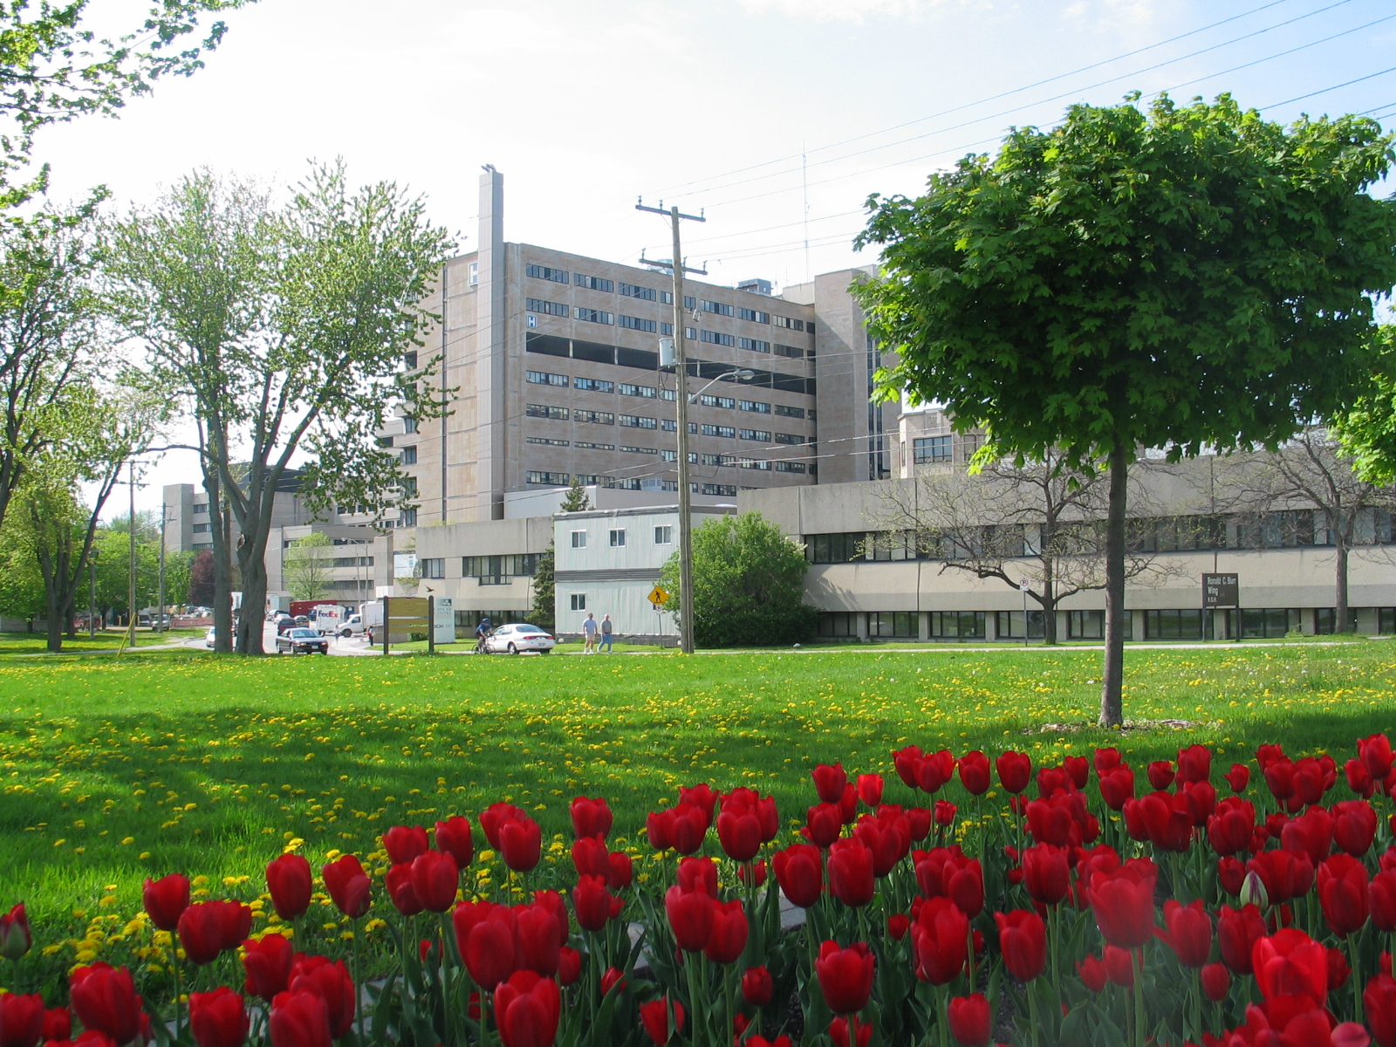
Personal Safety & Crime Prevention Tips
With the large number of people that access the hospital each day, and units that are relatively “open” to the public, KGH is a prime target for those wishing to acquire other people's property.
There are some steps that you can take to reduce the likelihood of you or your work area being at risk.

Slide 22
Personal Safety & Crime Prevention Tips
Avoid bringing valuables to the hospital
Lock up anything you must bring
Always wear your student ID badge at chest level. This is required by KGH’s Hospital Identification Policy #02-010
Notify security of suspicious persons and those in restricted areas without a hospital ID badge.
Upon discovery of a missing item or damaged property, notify KGH Security.
At night, always walk in groups; security escorts are available when walking to/from your vehicle; a security escort can be arranged through the Security (Davies 1).

Slide 23
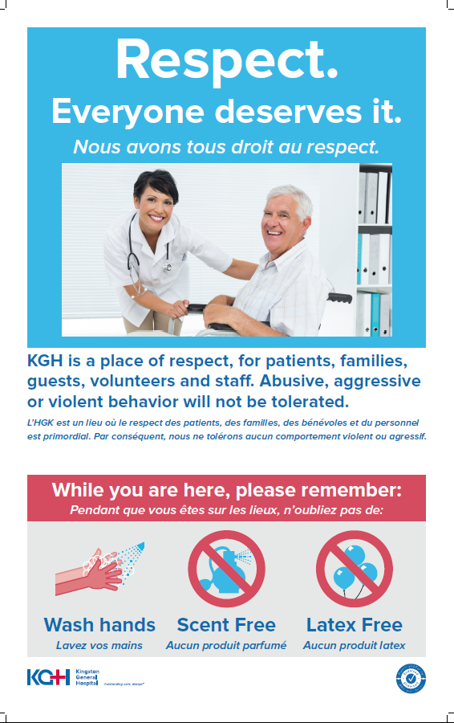
Workplace Violence Prevention
KGH is committed to providing a work environment that is safe, secure and respectful of each individual where all staff, including students, are free from exposure to violent, abusive and threatening behaviour and potentially violent acts in our environment.
KGH will not tolerate any form of violence or harassment by staff, patients or visitors.

Slide 24
Responding to Violence
Call a CODE WHITE (x4444) or have someone nearby call immediately.
  Don’t wait until the situation is ‘out of control’ before calling a Code White
Do not approach the person alone
  Ask a co-worker or security staff to accompany you
Maintain a safe distance (5 to 7 feet)
Maintain a clear exit
Do not turn your back on the aggressive person or make any sudden movements

Slide 25
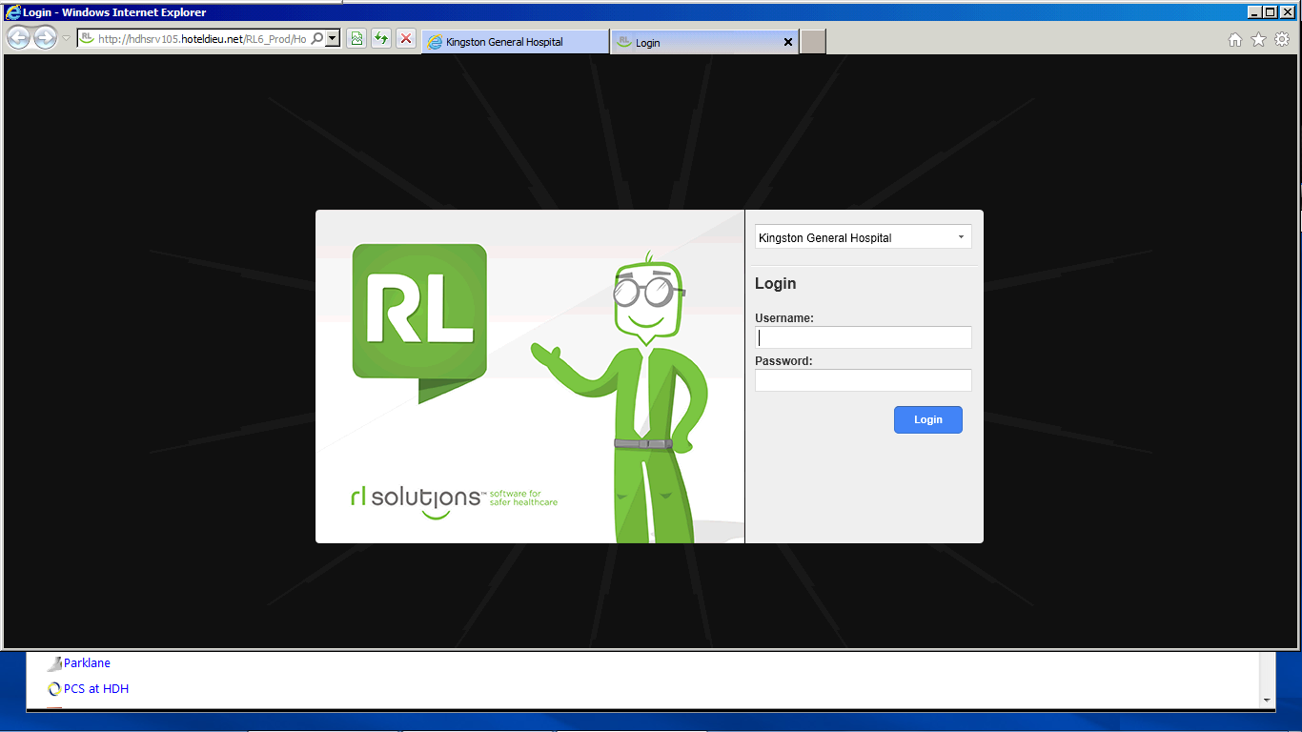
Responding to Violence
Should you be involved in a violent episode or sustain a injury as a result of violence or aggression
Obtain first aid/medical attention from Occupational Health, Armstrong 1, during regular business hours
Visit the Emergency Department if after hours and your injury requries emergency health care attention
Notify the most responsible person in your department/unit (e.g. Supervisor)
Enter the details of the incident or injury into the Safe Reporting Tool
Notify your school of the incident.

Slide 26

Workplace Harassment
Under the Occupational Health & Safety Act, harassment is defined as: “engaging in a course of vexatious comment or conduct against a worker in a workplace that is known or ought reasonably to be known to be unwelcome.”
It can include:
  Unwelcomed teasing
  Harmful gossip
  Ridicule
  Bullying
  Intimidation
  Offensive language or jokes
  Other breaches of the KGH Code of Behaviour

Slide 27
Bullying in the Workplace
Bullying is defined as repeated and persistent negative acts towards one or more individuals, where there is a real or perceived power imbalance and which creates a hostile work environment.
Examples may include:
Social Isolation | Withholding information
Over-monitoring of work | Rumours
Excessive criticism | Verbal aggression
Withholding job responsibility
Personal attacks on a person’s private life and/or personal attributes

Slide 28
Resources available to Students
Are you a victim of harassment or bullying and not sure where to turn to? The following resources can help:
  Your school, clinical instructor, academic advisor;
  A KGH HR Advisor;
  A KGH Peer Partner - see KGH wellness website www.kghwellness.ca
  A KGH Occupational Health Nurse
  Sexual Assault and Domestic Violence Program (KGH)
  The hospital’s Joint Health & Safety Committee (JHSC

Slide 29
Infection Prevention & Control
Preventing the spread of infectious illness to our patients, our staff, and others
within the hospital is critical.
Patients are often immunocompromised which means they may not be able to
fight off an infection as well; acquiring an infection can impair their health and
recovery, extend their length of stay, and in some cases, can result in death.
Getting your annual Influenza (flu) vaccination,
along with diligent hand hygiene are key
strategies for patient and staff safety.

Slide 30
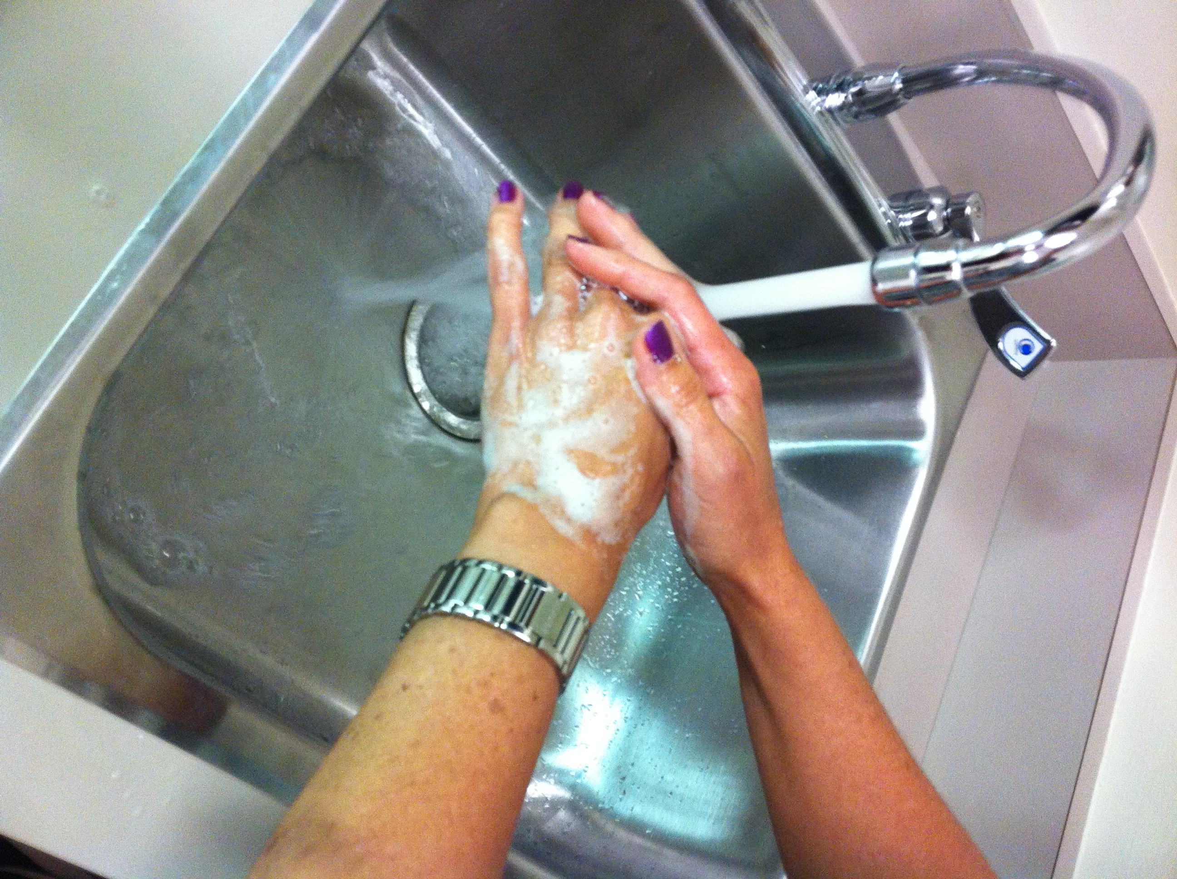
Hand Hygiene Requirements
  Alcohol-based hand sanitizer can be used for routine hand washing where your hands are not visibly soiled or contaminated with blood or body fluids;
  If hands are visibly soiled, use soap and warm water
  Studies demonstrate that hand hygiene removes disease causing microorganisms and prevents transmission and is the single most important step you can take in preventing infection in your patients.

Slide 31
Infection Prevention & Control
For students carrying on activities in a healthcare environment, the Public Hospitals Act requires that the Communicable Disease Surveillance Protocols developed by the OMA/OHA be followed. These protocols outline the immunity requirements for all those working in a hospital and are intended to prevent the spread of infection between patients and staff in hospitals.
There are protocols for Measles, Mumps, Rubella, Varicella (chicken pox), Pertussis (whooping cough), Meningococcal Disease, Scabies, Tuberculosis (TB), and Influenza to name a few.
In order to undertake a placement at KGH, all students must meet the immunity requirements and your school must validate that you have met the requirements prior to starting your placement at KGH.
To learn more about what proof of immunity is required
for KGH Affiliates working in the hospital,
visit the OHA website http://www.oha.com/SERVICES/HEALTHSAFETY/Pages/CommunicableDiseasesSurveillanceProtocols.aspx

Slide 32
Infection Prevention & Control
To prevent the spread of infectious illness within the hospital, you should avoid coming to the hospital if you have an infectious (communicable) illness. This includes:
1) Influenza-like Illness (ILI) or Acute Respiratory Illness (ARI) with a
fever greater than 38ºC and at least 3 of the following symptoms:
  cough (new or worse).
  shortness of breath
  chills or shakes
  headache or eye pain
  myalgias (body aches)
  malaise (severe fatigue)
  sore throat
Do not return to work until you have been fever-free for 48 hours.

Slide 33
Infection Prevention & Control
To prevent the spread of infectious illness within the hospital, you should avoid coming to work if you have an infectious (communicable) illness. This includes:
2) Gastroenteritis with at least 2 of the following symptoms:
  vomiting
  nausea
  diarrhea
  chills or shakes
  abdominal pain
Do not return to work until you have been diarrhea free for at least 24 hours
(48 hours if diarrhea is believed to be caused by noro-virus )

Slide 34
Infection Prevention & Control
To prevent the spread of infectious illness within the hospital, you should avoid coming to work if you have an infectious (communicable) illness. This includes:
3) Conjunctivitis (“pink eye”) caused by a bacterial or viral infection.
Infectious conjunctivitis is accompanied by redness and discharge and
is highly contagious.
4) And other infectious diseases as outlined in the Kingston Hospitals
Infection Control Manual.
For those working in clinical areas,
you cannot return until drainage has stopped.
If you are unsure if your symptoms are infectious you may consult with KGH Occupational Health, Safety & Wellness Department.

Slide 35

Summary
You have now completed your introductory Health & Safety Training required for all students coming on placement a KGH.
This material has only provided a summary of some safety-related information and has not covered all safety aspects that you may need to be aware of as a student. Additional training will be provided as part of your placement experience on the unit/department where you will be placed.
If you are ever unsure of how to safely perform a specific task or procedure, or how to safely use a piece of equipment, a medical device, or a sharp, STOP and make sure you ask for more information.
Ask yourself… do I have sufficient information to safely perform the task?

Slide 36
Welcome to KGH!
We hope you have a safe, rewarding, and enjoyable learning experience.

