Slide 1
REFRESHER Influenza Season Preparedness
South East IPAC Hub and Spoke Team
LGL Public Health Community of Practice
Dec 21, 2022

Slide 2
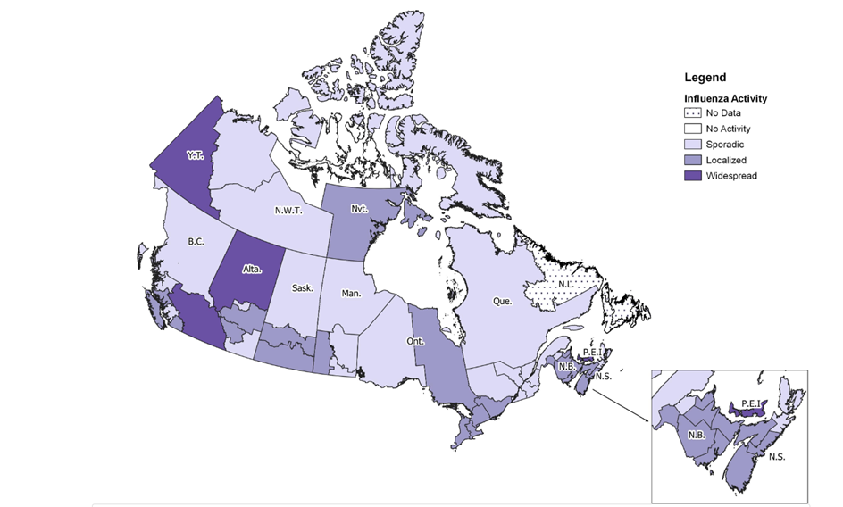
Overview
Currently in week 49 of the Flu watch report at:
Five KEY issues to consider to ensure preparedness:
  Anti-viral prophylaxis and treatment
  Exclusion from work
  Vaccination
  Testing and surveillance
  Routine and additional precautions
FluWatch Report ENG (canada.ca)
Image source: FluWatch report: December 4 to December 10, 2022 (week 49) - Canada.ca
Notes:
Today’s update will be on the following

Slide 3

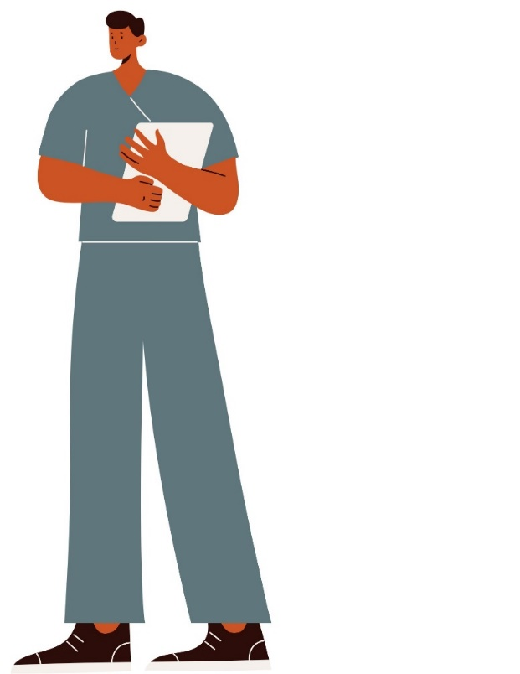
Vaccination
Vaccination during the Flu season is recommended for everyone age six months and older.
Get a Flu shot as soon as possible, as it takes two weeks to take effect.
Source: The flu | ontario.ca

Slide 4

Anti-Viral Medications
For prophylaxis:
In an influenza outbreak, antiviral medications are used for:
All residents (regardless of whether or not they have received the influenza vaccine).
Unvaccinated staff members (and rarely for vaccinated staff if recommended by the local public health unit).
For treatment:
Anyone with Influenza-Like Symptoms during the flu season and are at high risk of complications (65+ years, pregnant, comorbidities), regardless of outbreak status and regardless of vaccination status.

Slide 5

Anti-Viral Prophylaxis & Treatment
Preparedness
Antiviral medications must be prescribed by a doctor or nurse practitioner (NP).
If your facility has a physician or NP who provides care for the facility’s residents, make a plan in advance for all the residents.
This can be done by the use of a medical directive from the physician or nurse practitioner that indicates when and how to use antiviral medications in an outbreak.

Slide 6


No Dedicated Physician or NP?
If your facility does not have a dedicated doctor or nurse practitioner (NP):
  A prescription for antiviral medications (for treatment and/or for prevention) must be obtained from the residents’ own health care providers.
  Ideally, this prescription should be obtained before the start of the influenza season and kept on the resident’s file at the facility.

Slide 7

Pre-arrange with Pharmacy
If possible, have a pre-arranged plan with the pharmacy that supplies your facility to be able to obtain antiviral medications as quickly as possible if/when an influenza outbreak is declared in your facility.
Consider options for receiving antivirals after-hours and on weekends.
Be in touch with your pharmacy as soon as an outbreak is suspected so they can be prepared to provide the antiviral medications as soon as they are ordered by the health care provider.

Slide 8
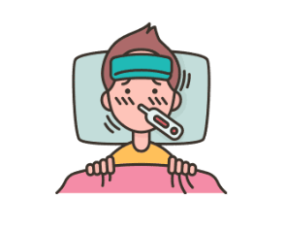

Staff Exclusions
Staff with symptoms:
Staff, students, or volunteers with any respiratory infection symptoms should not return to work/placement for 5 days from the onset of symptoms of a respiratory illness or until symptoms have resolved, whichever is shorter, regardless of vaccination status or taking antivirals
Staff without symptoms:
During a laboratory-confirmed influenza outbreak, immunized staff who has been immunized at least two weeks prior to outbreak declaration may work in the outbreak home.
Unimmunized staff may resume work at the affected home as soon as they are taking antiviral prophylaxis.
Staff cannot work at another facility not in outbreak until three days after stopping work at a home in an outbreak and no symptoms have developed.

Slide 9
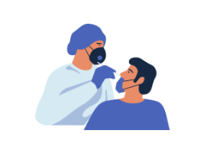
Testing Preparedness
Supplies can be ordered through eHealth, PHO, or the Public Health Unit.
If requesting from PHO, specimen containers and supplies are provided exclusively for samples that are to be tested by the Public Health Ontario Laboratories.
Current version of Public Health Laboratory requisitions are available at www.publichealthontario.ca/requisitions.

Slide 10


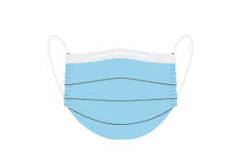

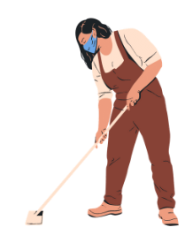
Routine & Additional Precautions, and Outbreak Control Measures
Hand Hygiene
PPE
Isolation of cases
Cohorting staff and residents
Visitor restrictions
Enhanced cleaning and disinfection
SE IPAC Hub Quick Education Videos:
IPAC Basics - What are Routine Practices? - YouTube
IPAC Basics - What are Additional Precautions? - YouTube

Slide 11

FOR CONGREGATE LIVING SETTINGS
Congregate settings have a more varied population, so treatment and vaccination have to be considered on an individual basis.
The following algorithm might help for treatment:
https://www.ammi.ca/Content/Guidelines/Flu_Algorithm.pdf

Slide 12

Happy Holidays from your
SE IPAC Hub & Spoke Team
General inbox: SEHubintake@kingstonhsc.ca
Statutory holidays:
Dec 26, 27 and Jan 2

Slide 13
Thank you

