Slide 1

SE IPAC Hub’s
IPAC Basics Education
A presentation on key infection, prevention and control basics intended for non-clinical staff

Slide 2

Objectives
After completing this education you should be able to answer:
What is Infection Prevention and Control?
What is the Chain of Transmission?
What are Routine Practices?
  What is Hand Hygiene?
  How do you protect yourself?
  What is Personal Protective Equipment (PPE) and how do you use it?
What are other infection prevention and control measures?

Slide 3
Terms
Staff: anyone employed by the organization/workplace
  Health care workers (RN, RPN, PSW)
  Non-clinical staff (Care aids, housekeeping/environmental services, dietary)
  Temporary and/or agency staff,
  Contractors,
  Students on placement and
  Volunteers
Germ = Pathogen = microorganism = that can be transmitted and cause colonization/infection/disease
Facility: any area where care is provided:
  Long Term Care Home, Retirement Home
  Ministry of Children, Community and Social Services organization
  Home & Community Care
  Hospitals
  Clinics
Client: an individual participating in services = resident/patient
Blood and Body Fluid: includes: blood, feces, urine, nasal secretions, mucus, saliva, vomit, semen, vaginal fluids, wound drainage, secretions and excretions

Slide 4
Intended Use
This presentation was created for non-clinical staff to provide an overview of basic IPAC concepts. These concepts should be practiced by ALL staff, at ALL times in ALL settings.

Slide 5
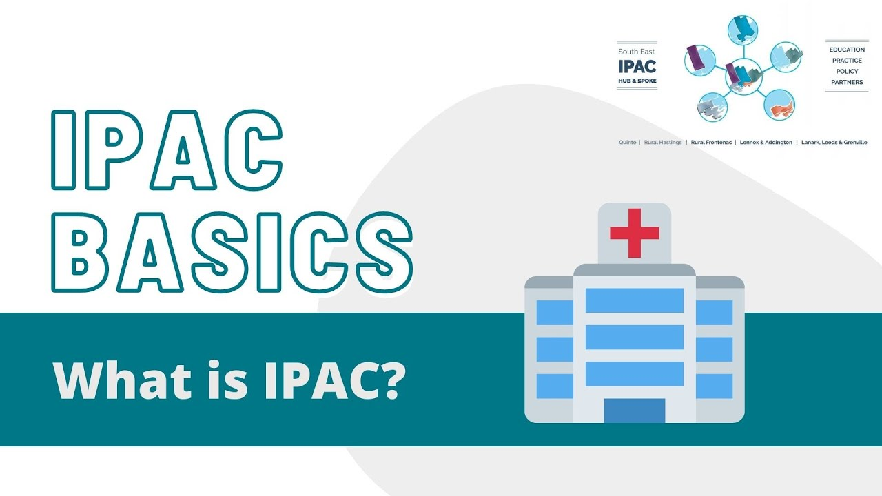
Click the image to watch the video or the link here: https://youtu.be/jOMQvRtBiV4
Notes:
Video link: https://youtu.be/jOMQvRtBiV4

Slide 6
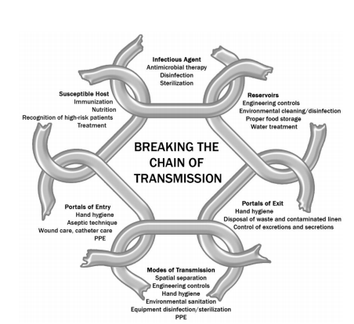
Goal of IPAC
Prevent and limit the spread of germs
Break a link in the chain of transmission
Increase the quality and safety of care
Create a safe and healthy space for all
Notes:
References:
Public Health Ontario: https://www.publichealthontario.ca/en/education-and-events/online-learning/ipac-courses
Ontario Agency for Health Protection and Promotion, Provincial Infectious Diseases Advisory Committee. Routine Practices and Additional Precautions in All Health Care Settings. 3rd edition. Toronto, ON: Queen’s Printer for Ontario; November 2012. Retrieved from: https://www.publichealthontario.ca/-/media/documents/B/2012/bp-rpap-healthcare-settings.pdf
The goal of IPAC is to prevent the spread of germs between everyone living, working or visiting in the facility. This helps to protect clients from developing infections, resulting in improved survival rates, reduced disease associated with infections, increased quality of care and improved quality of life. Infection Prevention & Control strategies are ultimately aimed at breaking at least one link in the Chain of Transmission.
You are going to get a refresher in IPAC education that will demonstrate the importance YOU play in IPAC in creating a healthy, safe space for all

Slide 7
Why is infection prevention important?
Healthcare Associated infections (HAIs) can result in severe complications and even death.
  In Canada its estimated that 220,000 incidents of HAI occur each year, resulting in around 8,500 - 12,000 deaths
Transmission and infections result in disease, suffering, death and increased costs to the healthcare system, organizations and to affected individuals and their loved ones.
Less transmission = fewer HAI = safer workplace = better quality of care
Notes:
Reference:
Ontario Agency for Health Protection and Promotion, Provincial Infectious Diseases Advisory Committee. Routine Practices and Additional Precautions in All Health Care Settings. 3rd edition. Toronto, ON: Queen’s Printer for Ontario; November 2012. Retrieved from: https://www.publichealthontario.ca/-/media/documents/B/2012/bp-rpap-healthcare-settings.pdf
Infection prevention measures limit the need to control infections or manage outbreaks of organisms. IPAC protects you and those around you from preventable infections, disease and promotes general wellness through implementing these practices in your daily routine both at work and at home.
Breaks, short cuts and lapses in IPAC will increase health and safety risks through exposures to pathogens and potential transmission or spread of germs not only to clients, but also to you, your colleagues, and all those you come in contact with – even outside of the workplace.
Germ transmission in healthcare is known as healthcare-associated infection (HAIs) and are defined as infections that occur as a result of health care interventions in any health care setting where care is delivered (e.g. congregate care settings, hospital, clinic, home and community care, etc.). Many HAI are resistant to antibiotics and like any infection can cause people to be very sick or even die. As the needs of clients increases so does the level of complex treatments outside of acute hospital care (e.g., oxygen, CPAP, BiPAP, ventilation, catheters, wound care, etc.). As a result the risk of transmission and infection spans across all settings weather in the hospital, home, shelter, temporary housing, LTCH, RH or other workplace.

Slide 8
What is the Chain of Transmission?
What is needed for germs to spread

Slide 9
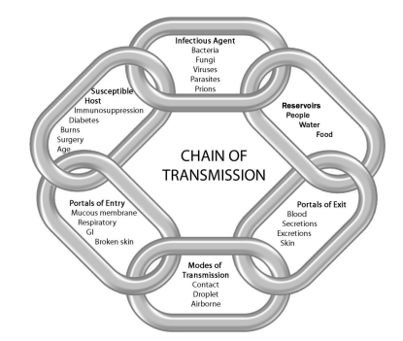
ALL items in the chain must be present for transmission to take place
Notes:
Reference:
Ontario Agency for Health Protection and Promotion, Provincial Infectious Diseases Advisory Committee. Routine Practices and Additional Precautions in All Health Care Settings. 3rd edition. Toronto, ON: Queen’s Printer for Ontario; November 2012. Retrieved from: https://www.publichealthontario.ca/-/media/documents/B/2012/bp-rpap-healthcare-settings.pdf
The chain of transmission is illustrated here as we use it as a model to explain how germs can be spread, and also how their spread can be prevented. Each link in the chain, must be present for these germs to spread and for infection to occur. An infectious agent is a microorganism or germ that is able to invade body tissue and multiply. There are many different types of reservoirs where germs can survive and multiply until there is an opportunity to exit the reservoir (e.g. germs leave the body through blood, bodily fluids, secretions and excretions that exit the respiratory tract, GI tract or broken skin). There are also different modes of transmission or spread of a germ, which we will discuss later. These modes of transmission allow the germs to spread from one person to another and if there is a portal of entry then that is where the germ will enter the body. Germs will enter any person who is susceptible to infection which could be caused by a variety of factors including age, immunocompromised or being unvaccinated.
All parts of the chain must be present for germs to spread, if one link is broken in the chain then transmission will not occur. We have to think about how we can break the chain and stop the spread of germs.

Slide 10
The Chain of Transmission
To stop transmission of germs you must break a link in the chain! There are many ways to do this.
Click here to watch a video to explain the chain of transmission
Notes:
Reference:
Ontario Agency for Health Protection and Promotion, Provincial Infectious Diseases Advisory Committee. Routine Practices and Additional Precautions in All Health Care Settings. 3rd edition. Toronto, ON: Queen’s Printer for Ontario; November 2012. Retrieved from: https://www.publichealthontario.ca/-/media/documents/B/2012/bp-rpap-healthcare-settings.pdf
To stop germs from spreading just one link in the chain needs to be broken to prevent transmission. There are many ways to stop the spread of germs including proper hand hygiene, wearing the appropriate personal protective equipment and cleaning and disinfection to name a few. Hand hygiene is an example that can break many of the items in the chain to prevent transmission.
Lets watch a video to help explain Breaking the Chain of Transmission - Stop the Spread of Germs – YouTube

Slide 11
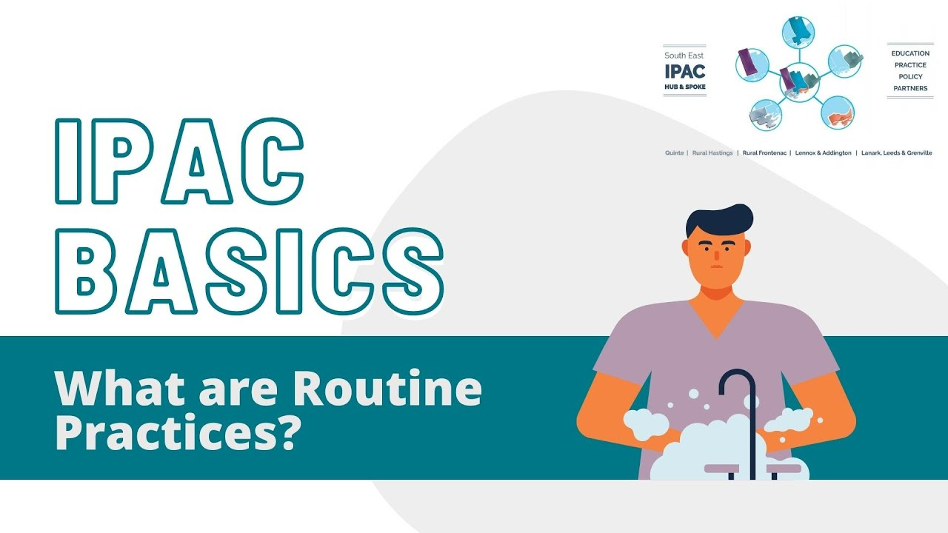
Click the image to watch the video or the link here: https://youtu.be/eQQYv0pGF5o
Notes:
Reference:
Ontario Agency for Health Protection and Promotion, Provincial Infectious Diseases Advisory Committee. Routine Practices and Additional Precautions in All Health Care Settings. 3rd edition. Toronto, ON: Queen’s Printer for Ontario; November 2012. Retrieved from: https://www.publichealthontario.ca/-/media/documents/B/2012/bp-rpap-healthcare-settings.pdf
Video Link: https://youtu.be/eQQYv0pGF5o
Infection prevention and control practices used by staff can reduce the risk of transmitting germs to and from clients and staff in all settings.
Routine practices refer to the minimum IPAC practices or measures that should be used with all clients. Let's begin with reviewing a video https://youtu.be/eQQYv0pGF5o

Slide 12

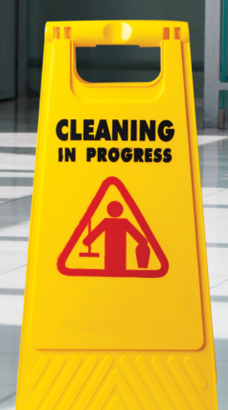
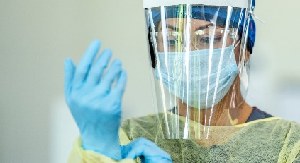
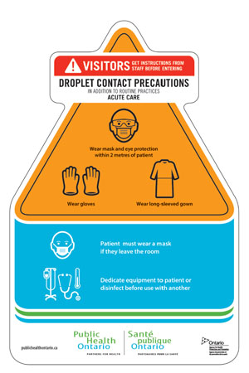

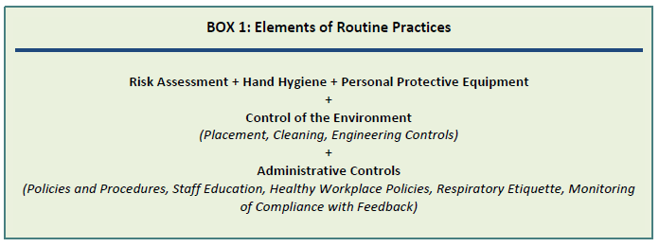
Routine Practices
Everyday practices used by staff that reduce or eliminate the risk of spreading germs. We will review the following elements of routine practices:
Hand Hygiene
Point of Care Risk Assessment (PCRA)
Personal Protective Equipment (PPE)
Control of the Environment
  Client placement
  Equipment cleaning
  Environmental Cleaning
  Safe handing of sharps
  Laundry
Administrative controls
  Policies & procedures
  Training & Education
  Staff immunization
  IPAC audits
Routine Practices means you treat everyone as if they are infectious and can spread germs to you
Notes:
References:
Ontario Agency for Health Protection and Promotion, Provincial Infectious Diseases Advisory Committee. Routine Practices and Additional Precautions in All Health Care Settings. 3rd edition. Toronto, ON: Queen’s Printer for Ontario; November 2012. Retrieved from: https://www.publichealthontario.ca/-/media/documents/B/2012/bp-rpap-healthcare-settings.pdf
Public Health Ontario Infection Prevention and Control Fact Sheet: Routine Practices https://www.publichealthontario.ca/-/media/documents/i/2012/ipac-routine-practices.pdf?sc_lang=en
Routine Practices are based on the concept that all clients are potentially infectious and can spread germs, even when they are not showing any signs or symptoms. Because of this the same safe standards of work should be used all the time, with all clients during all interactions to prevent exposure to blood, body fluids, secretions, excretions, mucous membranes, non-intact skin or soiled items, and the client environment. Routine practices are the minimum standard to be used to provide protection and reduce or potentially eliminate the risk of spreading germs. We will review the following elements of routine practices: Hand Hygiene, Point of Care Risk Assessment, Personal Protective Equipment (PPE), Control of the Environment through: Client placement, Equipment cleaning, Environmental Cleaning, Safe handing of sharps, Laundry and administrative controls such as: Policies & procedures, Staff immunization and infection prevention and control audits

Slide 13
Hierarchy of Control
Notes:
References:
Ontario Agency for Health Protection and Promotion (Public Health Ontario). Infection prevention and control for long-term care homes: summary of key principles and best practices. Toronto, ON: Queen’s Printer for Ontario; 2020. Retrieved from: https://www.publichealthontario.ca/-/media/documents/i/2021/ipac-ltch-principles-best-practices.pdf?sc_lang=en
Ontario Agency for Health Protection and Promotion, Provincial Infectious Diseases Advisory Committee. Routine Practices and Additional Precautions in All Health Care Settings. 3rd edition. Toronto, ON: Queen’s Printer for Ontario; November 2012. Retrieved from: https://www.publichealthontario.ca/-/media/documents/B/2012/bp-rpap-healthcare-settings.pdf
The National Institute for Occupational Safety and Health (NIOSH). (Janurary, 2015). Hierarchy of Controls. Retrieved from: https://www.cdc.gov/niosh/topics/hierarchy/default.html
The hierarchy of IPAC control is similar to routine practices with the thought that control methods at the top of graphic are potentially more effective than those at the bottom. Following this hierarchy normally leads to the implementation of safer systems, where the risk of illness or injury has been substantially reduced by following the hierarchy to control risk of transmission.
1. Elimination & substitution of face-to-face contact is the preferred control, using services such as telehealth medicine, or promotion of work from home options where possible. Isolation and cohorting of symptomatic or confirmed residents/clients/patients and physical distancing between individuals would also be examples of elimination and substitution.
While elimination and substitution are thought to be the most effective at reducing hazards, they also tend to be the most difficult to implement in an existing process or are not often feasible or possible to implement fully, especially in care settings as there is a need for inperson interactions and direct care.
2. Engineering & System control measures reduce or eliminate exposure by isolating the hazard from the employee and by physically directing actions to reduce the opportunity for human error. Examples include rigid barriers at the interface between the patient and staff at reception and point of care sharps containers, alcohol-based hand rub and PPE racks. Ventilation examples include airborne infection isolation room (AIIR) and optimizing the fresh air changes in the heating ventilation and air conditioning (HVAC) system to improve indoor air quality.
3. Administrative Controls are measures to reduce the risk of transmission through the implementation of policies, procedures, training and education. Examples of administrative controls, active and passive screening signage, restricted visitor policies, hand hygiene, cleaning and immunization policies. In addition, administrative controls include policies regarding restricting entrances, cohorting of staff and patients and designated centres for screening or treating patients.
4. Personal Protective Equipment controls are the most visible of the hierarchy of controls, PPE is defined as the appropriate use of physical barriers between staff and germs, to minimize exposure and prevent transmission. PPE is the last tier in the hierarchy as they rely solely on the worker, appropriate use of PPE through proper training and education. Examples of PPE barriers include gloves, gowns, facial and eye protection.

Slide 14
What is Hand Hygiene?
hand washing & hand sanitizing

Slide 15
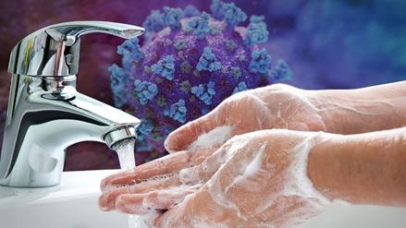
Hand Hygiene
Hand washing removes germs on hands with soap & water
Hand sanitizing kills germs on hands with alcohol based hand rub (70-90% alcohol)
Need to maintain skin integrity (no open areas, cuts, etc.)
Is the responsibility of ALL individuals in the workplace
Alcohol based hand rub
Soap & Water
Hand hygiene is the SINGLE most important measure to prevent the spread of infection and will break the chain of transmission!
Notes:
Reference
Ontario Agency for Health Protection and Promotion (Public Health Ontario), Provincial Infectious Diseases Advisory Committee. Best Practices for Hand Hygiene in All Health Care Settings. 4th ed. Toronto, ON: Queen’s Printer for Ontario; January 2014. Retrieved from: https://www.publichealthontario.ca/-/media/documents/b/2014/bp-hand-hygiene.pdf?la=en
Proper hand hygiene is the single most important measure to prevent the spread of germs as the hands are the most common source for transmission. Hands can transmit germs with everything to everyone they touch: from client to other clients, staff or from the client to equipment and the environment.
Hand hygiene is the removal of visible contaminants and removal or killing of organisms on the hands while also maintaining good skin integrity. The two methods of hand hygiene are: hand sanitizing with the use of alcohol based hand sanitizer (ABHR) that has a concentration of 70-90% or by hand washing with soap and running water (warm or cold), which must be done if the hands are visibly soiled.
Only liquid soap is to be used and not bar soap; bar soap can only be used for individual client use.

Slide 16
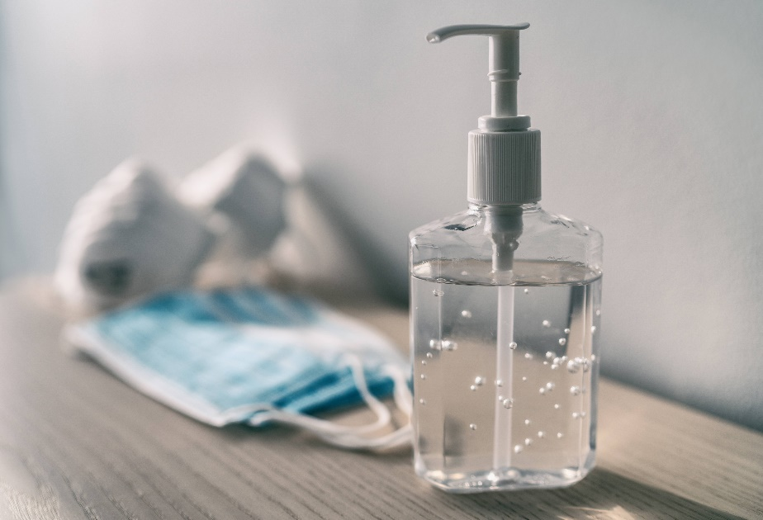
Alcohol Based Hand Rub (ABHR)
What to look for when using an ABHR:
Contains alcohol as the active ingredient
Concentration 70-90%
Has a Natural Product Number (NPN)
Is not expired
Use on hands that are not visibly dirty
If your hands LOOK dirty, you must use soap and water
Notes:
Reference
Ontario Agency for Health Protection and Promotion (Public Health Ontario), Provincial Infectious Diseases Advisory Committee. Best Practices for Hand Hygiene in All Health Care Settings. 4th ed. Toronto, ON: Queen’s Printer for Ontario; January 2014. Retrieved from: https://www.publichealthontario.ca/-/media/documents/b/2014/bp-hand-hygiene.pdf?la=en
ABHR needs to meet the criteria shown on this slide. Hand hygiene with soap and water must be done when hands are visibly soiled with dirt, blood or body fluids. For alcohol based hand rub you want the concentration to be at least 70% to inactivate norovirus and not higher than 90% as it won’t be as effective at killing the microorganisms. Only alcohol based hand sanitizer can be used. Non-alcohol based products that contain a quaternary ammonium compound cannot be used as they have not been shown to be as effective as soap and water or ABHR against microorganisms. They are also prone to contamination and can be a skin irritant. The alcohol based hand sanitizer must have a Natural Product Number (NPN) on the bottle. The NPN means that is approved from Health Canada and the active concentration of alcohol can be searched on the Health Canada database.

Slide 17
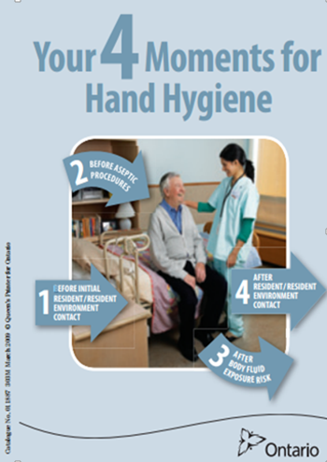
Moments of Hand Hygiene
BEFORE:
Contact with a client or their space
Putting on personal protective equipment (PPE)
Providing direct care
Handling/serving client food
AFTER:
Contact with a client or their space
Contact with items in the clients environment
Providing direct care
Removing PPE
To keep it simple ALWAYS perform hand hygiene BEFORE and AFTER contact with a contaminated space, client, or anytime hands are visibly soiled!
Notes:
Performing hand hygiene protects the client, the staff member and any other individuals in the facility. Hand hygiene needs to be performed before contact with a client or before contact occurs with their environment. Remember the environment is any area or object within 2m (6ft) of the client. Performing hand hygiene after contact with body fluids, a resident or a resident’s environment helps to protect the staff member and other residents. It is also beneficial to participate in routine monitoring of hand hygiene through to ensure compliance and assess moments for improvement, education or training.

Slide 18
Important times for hand hygiene
You can help yourself and your loved ones stay healthy by washing your hands often, especially during these key times when you are likely to get and spread germs:
Before, during, and after preparing food
Before and after eating food
Before and after caring for clients
Before and after treating a cut or wound
After using the toilet
After changing diapers/briefs or assisting a client with toileting
After blowing your nose, coughing, or sneezing
After touching an animal, animal feed, or animal waste
After handling pet food or pet treats
After touching garbage
Notes:
Reference:
https://www.cdc.gov/handwashing/when-how-handwashing.html

Slide 19
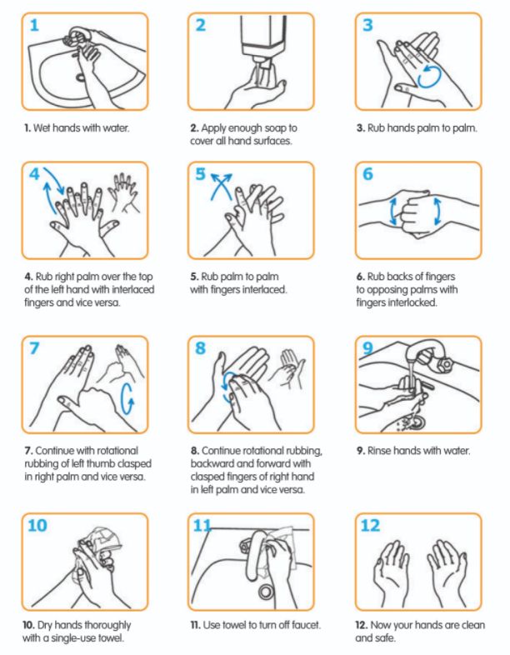

How to Hand Wash
Click the image to watch the video
Notes:
Video link: https://www.youtube.com/watch?v=o9hjmqes72I
Please refer to this video for a demonstration on how to correctly perform hand hygiene with soap and water.

Slide 20

How to Hand Sanitize
Click the image to watch the video
Notes:
Video link: https://www.youtube.com/watch?v=sDUJ4CAYhpA
Please refer to this video for a demonstration on how to correctly perform hand hygiene with alcohol based hand rub.

Slide 21
Tips for Proper Hand Hygiene
Do’s
At least 15 seconds
Clean wrists and forearms
Clean all parts of hands (fingers, backs, thumbs, too!)
Use lotion to keep skin in good condition
Keep nails short
Don’ts
Wear jewelry during hand hygiene
No artificial nails
No chipped nail polish
Notes:
As demonstrated in the previous videos, hands must be cleaned for a minimum of 15 seconds. Want to pay special attention to certain areas on the hands including the fingertips, between fingers and back of hands and base of thumbs. When using ABHR, rub hands until they are dry. Fingernails need to be short and not contain chipped nail polish or artificial nails as it may harbour germs.

Slide 22
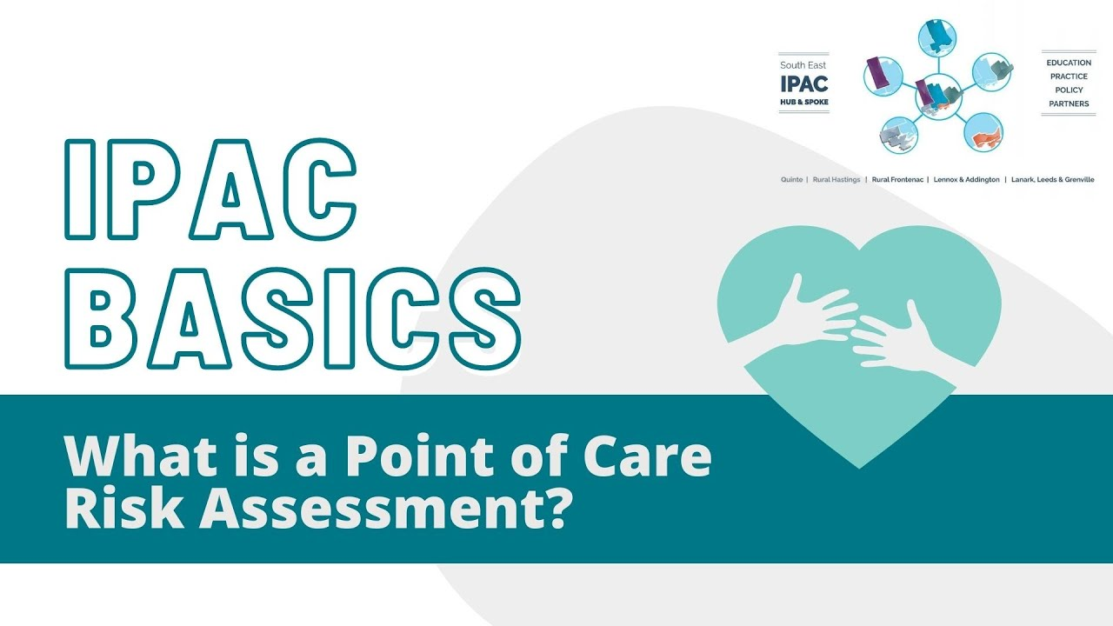
Click the image to watch the video or the link here: https://youtu.be/xqFcawImn-8
Notes:
Reference:
Ontario Agency for Health Protection and Promotion, Provincial Infectious Diseases Advisory Committee. Routine Practices and Additional Precautions in All Health Care Settings. 3rd edition. Toronto, ON: Queen’s Printer for Ontario; November 2012. Retrieved from: https://www.publichealthontario.ca/-/media/documents/B/2012/bp-rpap-healthcare-settings.pdf
Video link: https://youtu.be/xqFcawImn-8
What is a PCRA? Click here to learn more https://youtu.be/xqFcawImn-8
The risk of transmission of microorganisms between individuals involves the elements of the chain of transmission as was previously discussed. Transmission risk also changes with each interaction with a client and the environment.
The point of care risk assessment is specific to each individual and interaction. A point of care risk assessment of each client’s potential risk of transmission of microorganisms must be made by staff who come into contact with them or their environment. A Point of Care risk assessment is always the first step in routine practices. Your PCRA is used by ALL staff, for ALL clients, for ALL interactions – BEFORE any encounter or interaction with the resident/client/patient or environment.

Slide 23

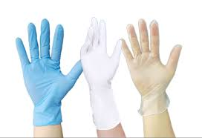
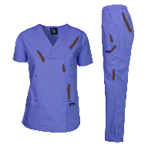
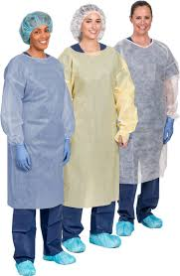

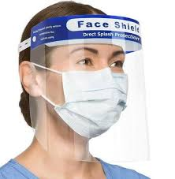
Risk Assessment Steps
ASSESS the TASK, the INDIVIDUAL and the ENVIRONMENT prior to EACH INTERACTION
Will my hands be exposed to BBF* or contaminated items?
YES
Perform hand hygiene, wear gloves
Will my clothing or skin become soiled from splashes/sprays of contact with items contaminated with BBF*
YES
Perform hand hygiene, wear a gown
Perform hand hygiene before and after PPE use
Will my eyes or face or mucus membranes be splashed or sprayed with BBF* or within 2 meters of a coughing or vomiting patient?
Environment: any area within 2m (6ft) of the patient or the immediate space around a client that may be touched by the client AND may also be touched by staff when performing tasks. This also includes the clients belongings and their bathroom.
BBF: blood and bodily fluids includes: urine, feces, wound drainage, saliva, vomit, sputum, nasal secretions, semen, vaginal secretions
YES
Perform hand hygiene, wear facial protection (mask & eye protection)
Notes:
Source:
Alberta Health Services: https://www.albertahealthservices.ca/ipc/hi-ipc-routine-practices-algorithim-cc.pdf
Ontario Agency for Health Protection and Promotion, Provincial Infectious Diseases Advisory Committee. Routine Practices and Additional Precautions in All Health Care Settings. 3rd edition. Toronto, ON: Queen’s Printer for Ontario; November 2012. Retrieved from: https://www.publichealthontario.ca/-/media/documents/B/2012/bp-rpap-healthcare-settings.pdf
Your point of care risk assessment will help you decide what, if any, PPE you need to wear to protect yourself and to prevent the spread of germs. Perform a Point of Care Risk Assessment, regardless of the disease or infection status of the client or if they are showing any symptoms. ASSESS the TASK, the INDIVIDUAL and the ENVIRONMENT Prior to EACH INTERACTION. The environment is any area within 2m (6ft) of the client or the immediate space around them that may be touched AND may also be touched by staff when performing tasks. This also includes the client’s belongings and bathroom. **Remember PCRA is the first step in RP. RP must be used with ALL patients, for ALL interactions.
Ask yourself:
Will my hands be exposed to BBF or contaminated items?
Will my clothing or skin become soiled from splashes/sprays or contact with items contaminated with BBF?
Will my eyes or face or mucus membranes be splashed or sprayed with BBF* or am I within 2 meters of a coughing or vomiting client?
If yes to any of these you will require PPE.
Decide on the required PPE item(s) to safely complete your task – remember HH BEFORE you grab PPE to prevent contaminating PPE supply, and HH after you removed contaminated PPE.
If you have concerns or questions about the required PPE or precautions a client is on, ALWAYS speak with the most responsible person to determine any risks, additional precautions or other considerations required before interacting with the client and their environment.

Slide 24
How do you protect yourself?
Personal protective equipment (PPE)
Notes:
PPE is the last control measure on the hierarchy of control, as it is the last line of protection in the interaction between staff and the client– proper PPE use is extremely important to limit contamination and spread of organisms.
If you are not confident in your IPAC practices you MUST tell someone to have more training/education and to ensure you are working safely and not putting yourself or others at risk. When you work with uncertainty in IPAC you put everyone at risk. If you think you could benefit from IPAC training and education talk to your supervisor or manager and have them connect with the IPAC Hub to provide on site education and training!
.

Slide 25
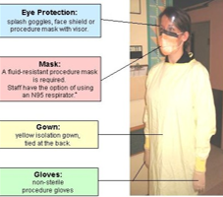
Personal Protective Equipment (PPE)
PPE prevents transmission and keeps staff safe.
Proper use is critical
  misuse can lead to transmission and waste PPE supplies
  Wearing more PPE than necessary is not safer (e.g., goggles and face shield, or multiple layers of PPE); because,
  When you remove PPE you risk contaminating yourself (e.g touching your skin with contaminated hands)
PPE should not interfere with your tasks
Any issues with PPE must be reported to your manager (e.g., damaged or defective items)
More PPE ≠ more safe – taking off PPE is when you risk contaminating yourself
Only wear the PPE that is required, do not wear multiple layers
Notes:
Reference:
Ontario Agency for Health Protection and Promotion, Provincial Infectious Diseases Advisory Committee. Routine Practices and Additional Precautions in All Health Care Settings. 3rd edition. Toronto, ON: Queen’s Printer for Ontario; November 2012. Retrieved from: https://www.publichealthontario.ca/-/media/documents/B/2012/bp-rpap-healthcare-settings.pdf
Proper PPE use prevents organism transmission and helps to keep staff and clients safe. PPE is used in various combinations to prevent exposure, by placing a barrier between the infectious source and one’s own mucous membranes, airways, skin and clothing. Selection of the appropriate PPE is based on the point of care risk assessment, and when worn appropriately, is what works to break the chain of transmission. Proper use at the appropriate times helps to keep a reliable PPE supply and limit waste. When we do not wear PPE, or wear it improperly we risk contaminating our clothing, skin and equipment and then contaminating other areas in the facility such as: other client rooms or common areas, staff break rooms, documentation areas, offices etc.
More PPE is not always better as taking PPE off is the highest risk of contamination, so avoid layering PPE. PPE should not interfere with your tasks – if you need to adjust your PPE while performing your task, it may not have been secured well before, if you cannot see through your eye protection you need to get another pair. Any damaged or malfunctioning PPE or issues with PPE must be reported to your manager to determine a solution to ensure everyone is working safely.

Slide 26

Gloves
Must be worn for contact with mucous membranes, non-intact skin, tissue, blood, bodily fluids, secretions, and excretions.
Must use gloves for contact with equipment and environment surfaces contaminated with any of the above
Not required for activities for intact skin (e.g., bathing, dressing, vitals).
Wear the correct size for your hands
Perform hand hygiene before and after glove use
Gloves are task-specific, single use – do not wash or reuse!
Notes:
Reference:
Ontario Agency for Health Protection and Promotion, Provincial Infectious Diseases Advisory Committee. Routine Practices and Additional Precautions in All Health Care Settings. 3rd edition. Toronto, ON: Queen’s Printer for Ontario; November 2012. Retrieved from: https://www.publichealthontario.ca/-/media/documents/B/2012/bp-rpap-healthcare-settings.pdf
Gloves must be worn when it is anticipated that the hands will be in contact with mucous membranes, non-intact skin, tissue, blood, body fluids, secretions, excretions, or equipment and environmental surfaces contaminated with any of the BBF mentioned.
Gloves are not required for routine health care activities in which contact is limited to intact skin of the client (e.g., taking blood pressure, bathing and dressing, delivering a meal tray).
Gloves are task-specific and single-use for the task. (e.g., cleaning a room using a wet cloth, change gloves perform HH before cleaning the next room or area; OR changing gloves after incontinence care).
Re-use of gloves has been associated with the spread of pathogens – Instead of your hands being contaminated your gloves become contaminated and your gloves should never be washed or reused (unlike your hands).
Ensure you wear the correct size so that they gloves don’t limit your ability to work safely.
Ensure hand hygiene is performed before and after glove use. – Before glove use is important to not contaminate the clean box of gloves

Slide 27
Gowns
Wear when there is a risk of splash/spray of blood or body fluids, to protect your skin and clothing.
Worn before entering the client environment or immediately before the task
Must be tied up to limit need to adjust (e.g., back done up to prevent contamination of clothing from curtains).
Remove with caution to prevent contamination of skin or clothing
Do not re-use gowns and change gown between clients
  Some are single-use disposable and some require laundering
  before re-use
Do not re-use a gown, always change it between clients!
Notes:
Reference:
Ontario Agency for Health Protection and Promotion, Provincial Infectious Diseases Advisory Committee. Routine Practices and Additional Precautions in All Health Care Settings. 3rd edition. Toronto, ON: Queen’s Printer for Ontario; November 2012. Retrieved from: https://www.publichealthontario.ca/-/media/documents/B/2012/bp-rpap-healthcare-settings.pdf
A gown is worn when it is anticipated that a procedure or care activity is likely to generate splashes or sprays of blood, body fluids, secretions, or excretions. Long-sleeved gowns protect the forearms and clothing of the staff from splashing and soiling with BBF and other potentially infectious material as well as contamination from the environment.
When a gown is required the gown should be put on immediately before the task, and worn so staff do not need to adjust or have the gown interfere with the task. (e.g., back done up to prevent contamination of clothing from the environment or having to adjust the gown)
The gown should be removed in a controlled way to prevent contamination of clothing or skin and then discarded. Do not re-use a gown or go between clients while wearing the same gown, even if they require the same precautions.

Slide 28
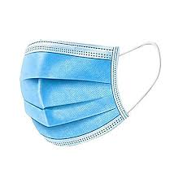
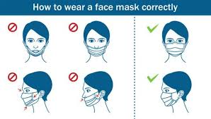
Masks
Wear to protect the mucous membranes of the nose and mouth when splash or spray of blood or body fluids is likely
Fits over nose, mouth and chin
Avoid touching the mask while wearing
Wash hands before and after touching your mask
Change when wet, visibly soiled, directly contaminated or difficult to breathe through
Notes:
Reference:
Ontario Agency for Health Protection and Promotion, Provincial Infectious Diseases Advisory Committee. Routine Practices and Additional Precautions in All Health Care Settings. 3rd edition. Toronto, ON: Queen’s Printer for Ontario; November 2012. Retrieved from: https://www.publichealthontario.ca/-/media/documents/B/2012/bp-rpap-healthcare-settings.pdf
Masks are used by staff (in addition to eye protection) to protect the mucous membranes of the nose and mouth when it is anticipated that a task is likely to generate splashes or sprays of blood, body fluids, secretions or excretions OR when staff are within two meters of a client showing respiratory symptoms (e.g., coughing). Your mask must fit over your nose, mouth and chin. You must always wash your hands before and after touching your mask, ideally avoid touching your mask while wearing it. If you are extending mask use, ensure it is stored in a designated space that will prevent transmission or contamination. ALWAYS change your mask when it is wet, visibly soiled, directly contaminated or difficult to breathe through.

Slide 29
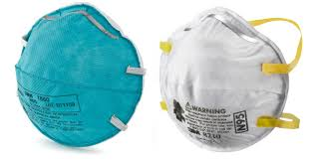
Respirators (N95, P100, etc.)
Worn to prevent inhalation of small particles, aerosolized respiratory droplets or
airborne particles
Only required in specific interactions:
Airborne diseases (e.g., measles, tuberculosis), and
Aerosol generating medical procedures (AGMP) (e.g. CPAP, BiPAP Machine) where an individual has respiratory symptoms or based on your facilities policy or your point of care risk assessment.
Must be fit tested to ensure proper fit, seal check before use to ensure no leaks
  If you are not fit tested to the mask for a proper fit, its no more effective than a procedural mask
Notes:
Reference:
Ontario Agency for Health Protection and Promotion, Provincial Infectious Diseases Advisory Committee. Routine Practices and Additional Precautions in All Health Care Settings. 3rd edition. Toronto, ON: Queen’s Printer for Ontario; November 2012. Retrieved from: https://www.publichealthontario.ca/-/media/documents/B/2012/bp-rpap-healthcare-settings.pdf

Slide 30
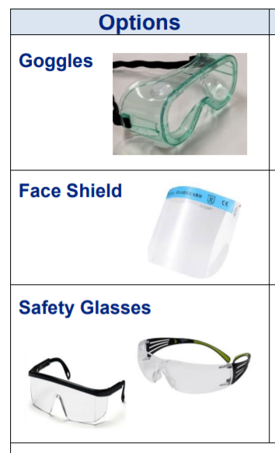
Eye Protection
Protects the eyes when splash/spray of blood or body fluids towards the face is likely
There are pros and cons to each type of eye protection
  Secure fit, tight against face and/or across the forehead or brow is best
Clean hands before and after touching/adjusting eye protection
Store in a designated space, to prevent transmission
PHO How to clean reusable eye protection document
If extending the use of eye protection:
  disinfect before breaks, storage and between clients who are infectious
Eye glasses are not considered eye protection
Notes:
Reference:
Ontario Agency for Health Protection and Promotion, Provincial Infectious Diseases Advisory Committee. Routine Practices and Additional Precautions in All Health Care Settings. 3rd edition. Toronto, ON: Queen’s Printer for Ontario; November 2012. Retrieved from: https://www.publichealthontario.ca/-/media/documents/B/2012/bp-rpap-healthcare-settings.pdf
Eye protection is used by staff to protect the mucous membranes of the eyes when it is anticipated that a procedure or task is likely to generate splashes or sprays of blood, body fluids, secretions or excretions OR when staff are within two meters of a coughing client. Eye protection includes: safety glasses, safety goggles, face shields, and visors attached to masks. There are Pros/cons to each type, however in general you want a secure fit, tight against your face and/or across the forehead is best. Clean your hands before and after touching/adjusting your eye protection, just like you do with your mask. If extending the use of your eye protection disinfect it before breaks, storage and between clients who are infectious. If extending the use, store eye protection in a designated space, in a way that prevents contamination based on your organizations requirements.
Eye protection may be disposable or reusable, if reusable, it should be cleaned prior to re-use. For instructions on how to clean reusable eye protection click here.

Slide 31
How do you use PPE?
Donning & doffing
Notes:
PPE should be put on just prior to the interaction with the client. After this interaction, PPE should be removed immediately and disposed of in the appropriate receptacle or cleaned/disinfected, and stored appropriately before the next use. Ideally contaminated PPE is disposed near the entrance to the client’s room or bed space to prevent contamination of common areas.
The process of PPE removal requires strict adherence to a formal protocol to prevent recontamination, this is why wearing additional PPE is not always helpful as it is difficult to take off extra PPE without contaminating yourself.

Slide 32
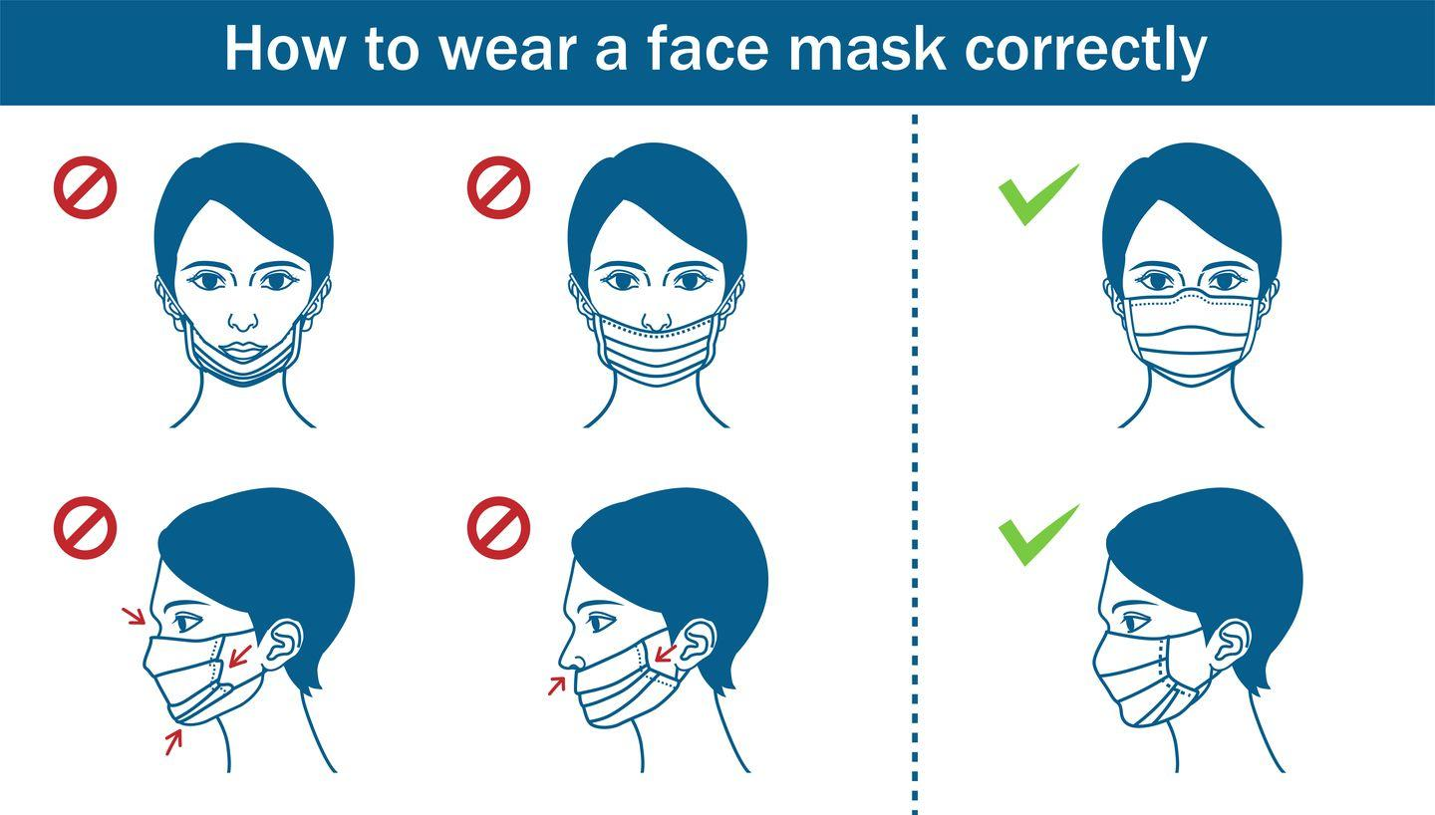

Using PPE Properly
Ensure you have received training & education on how to use available PPE
Ask yourself “What am I protecting myself against?”
Taking PPE off is more risky as it is likely contaminated with germs.
Any issues with PPE must be reported to your manager (e.g., damaged or defective items)
Not using PPE or using it improperly is everyone's business
  Hold each other accountable; transmission of germs affects everyone in the workplace
Notes:
Reference:
Occupational Health and Safety Act https://www.ontario.ca/laws/statute/90o01
Your employer is required to provide you with training and education on how to properly use the PPE that is available. Staff must know when and how to use PPE. Ask yourself – what am I protecting myself against? (contact, droplet, airborne? – what is the organism?).
Never alter PPE as this may increase your risk. (e.g., cutting face shields to be shorter). If there are issues or concerns with the PPE ensure you let your manager/supervisor know right away.
If you see someone not wearing PPE, or wearing it incorrectly, mention it to the staff member or visitor – these breaks in practices can affect us all.
OHSA lists additional specific duties:
Work in compliance with the Act and regulations;
Use any equipment, protective devices or clothing required by the employer;
Tell the employer or supervisor about any known missing or defective equipment or protective device that may be dangerous;
Report any known workplace hazard or violation of the Act to the employer or supervisor;
Not remove or make ineffective any protective device required by the employer or by the regulations.

Slide 33
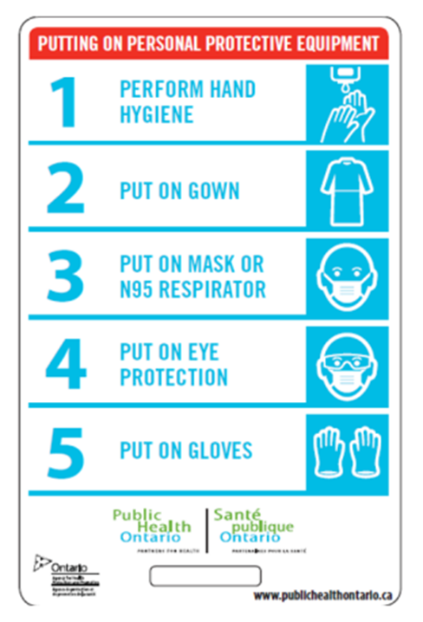
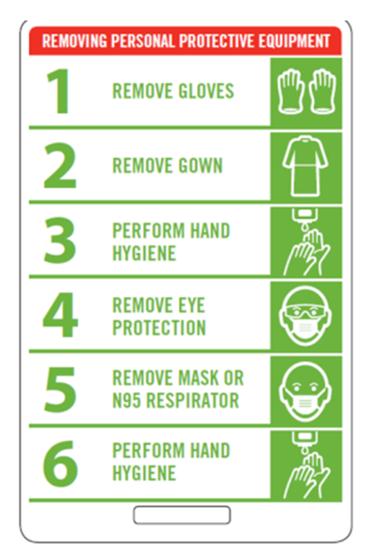
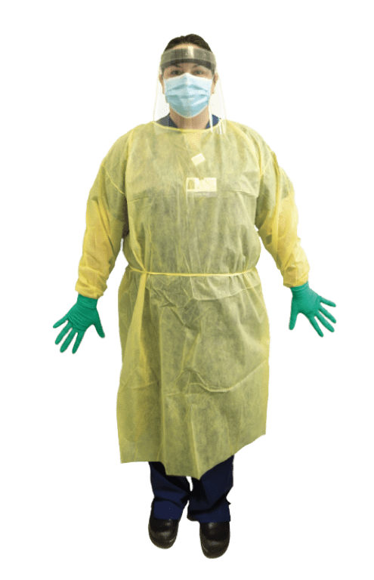




Donning and Doffing PPE
DON
DOFF
Watch instructional videos by clicking on each photo or video
Notes:
References:
Public Health Ontario. Putting on Full Personal Protective Equipment. Retrieved from: https://www.publichealthontario.ca/en/videos/ipac-fullppe-on
Public Health Ontario. Taking off Full Personal Protective Equipment. Retrieved from: https://www.publichealthontario.ca/en/videos/ipac-fullppe-off
Video links:
Putting On: https://www.youtube.com/watch?v=s2z1uM1fXN8
Taking Off: https://www.youtube.com/watch?v=crGlUX3_4DA
Please watch the following videos to review donning (putting on) and doffing (taking off) PPE.

Slide 34
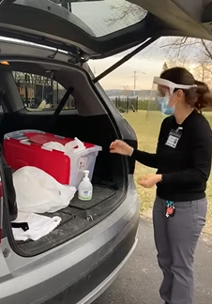
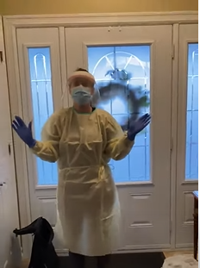
Donning & Doffing in the Community
Donning & doffing in settings outside of a typical health care facility offers unique challenges and requires a different approach. If you are travelling to various home and community settings during your work day, refer to our videos linked here
Notes:
Donning & doffing in settings outside of a typical health care facility offers unique challenges and requires a different approach. If you are travelling to various home and community settings during your work day, refer to these videos.
Video Links:
Donning
https://www.youtube.com/watch?v=ma_3NwDvIXU&list=PLSb2wofDF9Ykez8hqIecqDugzcaKRrwJ9
https://www.youtube.com/watch?v=n5eRk3pVZTI&list=PLSb2wofDF9Ykez8hqIecqDugzcaKRrwJ9&index=2
Doffing:
https://www.youtube.com/watch?v=8kgAKwLGXYM&list=PLSb2wofDF9Ykez8hqIecqDugzcaKRrwJ9&index=4
https://www.youtube.com/watch?v=J1N3cemE1zA&list=PLSb2wofDF9Ykez8hqIecqDugzcaKRrwJ9&index=3

Slide 35
Environmental Controls
Client placement, equipment and environmental cleaning and disinfection, safe handling of sharps and laundry
Notes:
Reference:
Ontario Agency for Health Protection and Promotion (Public Health Ontario), Provincial Infectious Diseases Advisory Committee. Best practices for environmental cleaning for prevention and control of infections in all health care settings. 3rd ed. Toronto, ON: Queen’s Printer for Ontario; 2018. Retrieved from: https://www.publichealthontario.ca/-/media/documents/b/2018/bp-environmental-cleaning.pdf
Environmental measures are used to control the risk of transmission within the environment. Some examples include:
appropriate placement and bed spacing (physical distancing)
cleaning of equipment in between uses
cleaning of the health care environment, including safe handling of soiled linen and waste (e.g., sharps) to prevent exposure and transmission to others
For the purpose of this education program we are including laundry and food safety in this section as many organizations require staff to not only care for clients but also perform cleaning and laundry. Lets start with learning about cleaning and disinfection.
Client placement
Equipment cleaning
Environmental Cleaning
Safe handing of sharps
Laundry

Slide 36
Dedicated Equipment
Dedicated equipment should be used for clients on additional precautions
If equipment cannot be dedicated it must be cleaned & disinfected between clients (e.g., stethoscope, commode, vitals machine)
All non-disposable equipment must be reprocessed as per manufacturer instructions for use
Supplies should be gathered outside before you don PPE, then brought into the room after PPE has been donned
  Avoid bringing in additional supplies to limit clutter
  All items brought into a client room must be reprocessed (as per manufactures instructions) before being used on another client or disposed of.
If it the equipment is shared, it must be cleaned & disinfected before reuse
Notes:
Reference:
Ontario Agency for Health Protection and Promotion, Provincial Infectious Diseases Advisory Committee. Routine Practices and Additional Precautions in All Health Care Settings. 3rd edition. Toronto, ON: Queen’s Printer for Ontario; November 2012. Retrieved from: https://www.publichealthontario.ca/-/media/documents/B/2012/bp-rpap-healthcare-settings.pdf
Equipment must be dedicated to the client/patient/resident whenever possible.
If equipment cannot be dedicated it must be disinfected between uses (e.g., stethoscope)
Supplies should be gathered outside, brought into the room after PPE has been put on. For example, if you are changing a client’s briefs, gather required supplies, donn your PPE outside of the room, and bring in all the materials you collected to use.
Avoid bringing in additional supplies as these are considered contaminated.
Items brought into the room must not be removed unless they can be cleaned/disinfected.

Slide 37
Communication
Have a communication plan ready if the client needs to leave the facility or be moved inside the facility, including the precautions they are on.
Ensure that any visitors are aware of the additional precautions
  How to perform hand hygiene
  How to use required PPE, and
  How to leave the room safely (e.g., how to remove PPE, perform HH).
Notes:
Reference:
Ontario Agency for Health Protection and Promotion, Provincial Infectious Diseases Advisory Committee. Routine Practices and Additional Precautions in All Health Care Settings. 3rd edition. Toronto, ON: Queen’s Printer for Ontario; November 2012. Retrieved from: https://www.publichealthontario.ca/-/media/documents/B/2012/bp-rpap-healthcare-settings.pdf
Effective communication regarding Additional Precautions is essential when a client goes to another department for testing, to another unit or to other health care settings/facilities. This communication must include Emergency Medical Services (EMS) staff and other transport staff (e.g., Taxi, patient transfer service). Have a communication plan for if the client needs to leave the facility, including the precautions they are on and why. Include the Transport service and Receiving facility in this discussion.
Ensure that visitors are aware of the additional precautions and how to perform hand hygiene, properly use required PPE and how to leave the room safely (e.g., how to remove PPE, perform HH).

Slide 38
What is Cleaning and Disinfection?
Compare cleaning & disinfection, reading product labels

Slide 39
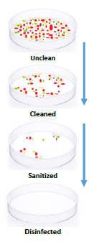
Cleaning and Disinfection
Cleaning:
  The physical removal of foreign material (e.g. dust, soil) and organic material (e.g. blood & body fluids and germs).
  Cleaning physically removes but does not kill microorganisms.
  Cleaning is accomplished with water, detergents and friction.
Sanitizing:
  Reduces germs identified on the product’s label.
  *Sanitizing is not appropriate for care settings – only cleaning and disinfection. Follow the products contact time for disinfection, not sanitizing.
Disinfection:
  Kills germs, but not bacterial spores
    e.g. Clostridioides difficile “C. Diff”
Cleaning must take place before disinfecting
Notes:
Reference:
Ontario Agency for Health Protection and Promotion (Public Health Ontario), Provincial Infectious Diseases Advisory Committee. Best practices for environmental cleaning for prevention and control of infections in all health care settings. 3rd ed. Toronto, ON: Queen’s Printer for Ontario; 2018. Retrieved from: https://www.publichealthontario.ca/-/media/documents/b/2018/bp-environmental-cleaning.pdf.
Cleaning and disinfection is a very important component in the protection of client and staff. Cleaning is the removal of dust or soil and organic material (e.g., blood, bodily fluids). Cleaning physically removes microorganisms through mechanical action (e.g., scrubbing), water and detergents. On the other hand, disinfection inactivates disease producing microorganisms. A cleaning step must be done prior to disinfecting; using a disinfectant on its own is not enough as many are inactivated by foreign or organic materials. Cleaners can be purchased separately from disinfectants but there are also one-step cleaner disinfectants available. If possible, it is beneficial to use these combined products for ease and simplicity of use; always ensuring the manufacturer’s instructions are followed.

Slide 40
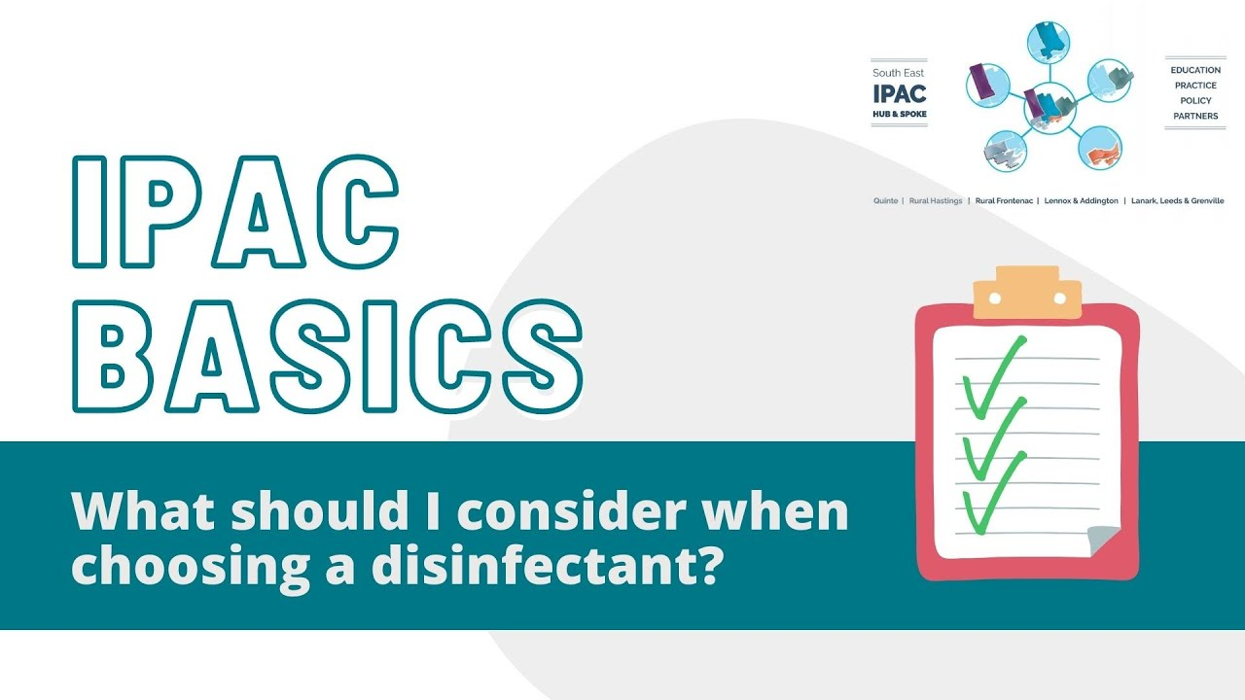
Click the image to watch the video or the link here: https://youtu.be/XhramUs4T2s
Notes:
Video link: https://youtu.be/XhramUs4T2s

Slide 41
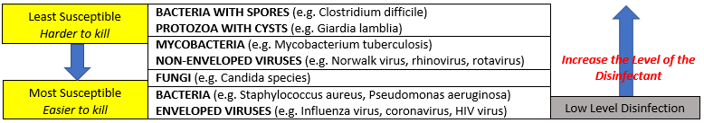
Microorganisms and Disinfectant Levels
Source: Health Canada. Hand washing, cleaning, disinfection and sterilization in health care [Internet]. Ottawa, ON: Government of Canada; 1998. {archived; cited 2021 August 3]. Retrieved from: https://publications.gc.ca/collections/collection_2016/aspc-phac/HP3-1-24-S8-eng.pdf
Notes:
Reference:
Health Canada. Hand washing, cleaning, disinfection and sterilization in health care [Internet]. Ottawa, ON: Government of Canada; 1998. {archived; cited 2021 July 28]. Retrieved from: https://publications.gc.ca/collections/collection_2016/aspc-phac/HP3-1-24-S8-eng.pdf
Health Canada. Hand washing, cleaning, disinfection and sterilization in health care [Internet]. Ottawa, ON: Government of Canada; 1998. {archived; cited 2021 August 3]. Retrieved from: https://publications.gc.ca/collections/collection_2016/aspc-phac/HP3-1-24-S8-eng.pdf
Microorganisms fall into different categories in regards to their susceptibility to disinfectants or how easy organisms can be killed. Some microorganisms are easier to kill than others. This is important to consider when assessing what disinfectant is appropriate and what level of cleaning and disinfection is required. For healthcare settings (location where health care is provided), only a hospital disinfectant with a DIN can be used; household products should not be used in healthcare settings. There are different levels of disinfectants, low, intermediate and high level disinfectants.
Low Level (LLD) = kills most vegetative bacteria and some viruses/fungi
Intermediate Level = kills vegetative bacteria, viruses, fungi and mycobacterium
High Level (HLD) = kills all microbial organisms but not necessarily bacterial spores – spores are the least susceptible to disinfectants
For example, using a disinfectant that only kills the microorganisms on the bottom group (low level disinfection) would not be appropriate if there was a Norwalk outbreak occurring in the facility as Norwalk requires an intermediate or high level disinfectant. Sporicidal disinfectant would be needed if there were any clients with C. difficile. It is important to know what organism you are concerned with and select a product with claims against it. We will now discuss what to look for in a disinfectant.

Slide 42
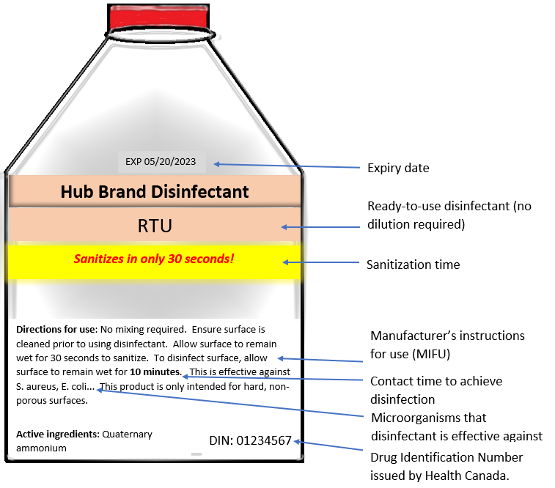
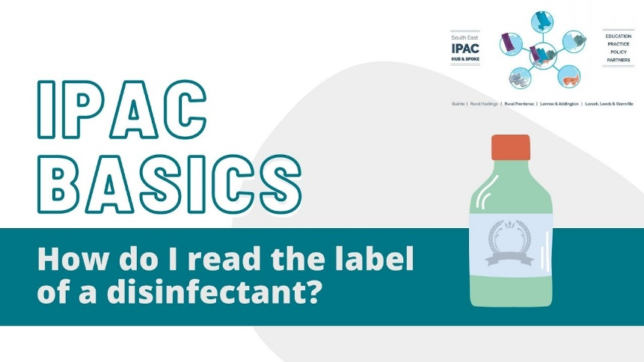
How do I read the Label?
Click the bottle to watch the video or the link here: https://youtu.be/eIb9Y08wFaA
Notes:
References:
Ontario Agency for Health Protection and Promotion (Public Health Ontario), Provincial Infectious Diseases Advisory Committee. Best practices for environmental cleaning for prevention and control of infections in all health care settings. 3rd ed. Toronto, ON: Queen’s Printer for Ontario; 2018. Retrieved from: https://www.publichealthontario.ca/-/media/documents/b/2018/bp-environmental-cleaning.pdf
Public Health Ontario. (July 30, 2021). Cleaning and Disinfection for Public Settings. Retrieved from: https://www.publichealthontario.ca/-/media/documents/ncov/factsheet-covid-19-environmental-cleaning.pdf
Public Health Ontario. (July 16, 2021). Key Elements of Environmental Cleaning in Healthcare Settings. Retrieved from: https://www.publichealthontario.ca/-/media/documents/ncov/ipac/2020/10/factsheet-covid-19-environmental-cleaning-hcs.pdf
There are many factors to consider when choosing an appropriate disinfectant for your facility – these include the contact/kill time, active ingredients, or if it is ready-to-use or requires dilution, to name a few. If we look at this diagram, we can see that this one is a ready to use disinfectant that requires no dilution, indicated by the RTU. A ready to use disinfectant is preferred over disinfectants that have to be diluted. If diluting the disinfectant is required ensure the manufacture's instructions are followed for the correct dilution. With any disinfectant you are diluting with water, including bleach, it is important to note how long the product is good for once diluted. Bleach loses potency within 24 hours, so a fresh solution needs to be made just before use or as often as required. It is also important not to mix different products (for example never mix bleach and ammonia).
Disinfectants require an 8 digit Drug Identification Number, or DIN as this means that it is approved for use by Health Canada. The exceptions to this are sodium hypochlorite and alcohol-based
disinfectants. Disinfectants can contain different active ingredients (e.g. quaternary ammonium, sodium hypochlorite, accelerated hydrogen peroxide etc). It is important to make sure that the disinfectant is effective against the microorganisms that you want killed. Always check the expiry date and follow the manufacturer's instructions for use, which could include what PPE is required to be worn or what surfaces are compatible with the disinfectant. Always wear the appropriate PPE that is indicated on the manufacturer’s instructions, or by your organization’s policies.
The contact time or kill time of the disinfectant will also be indicated on the bottle. It is important to follow the time required for disinfection and not sanitization as that will affect which germs are killed. The surface must remain wet for the entire contact time and then air dry. Shorter contact times are better as longer contact times require multiple re-applications so that the surface stays wet followed by air drying, never dry a surface manually.

Slide 43
Ideal Disinfectant Checklist
Effective against the appropriate microorganisms
Short contact time
Ease of use
Acts as a cleaner and disinfectant (one-step cleaner disinfectant)
Appropriate for use on the items and surfaces that require disinfection
Safe for use
Economical
Safe for the environment
Click here to check out our Choosing a Disinfectant tip sheet
Notes:
References:
Centers for Disease Control and Prevention. (September 18, 2016). Infection Control: Table 2. Properties of an ideal disinfectant. Retrieved from: https://www.cdc.gov/infectioncontrol/guidelines/disinfection/tables/table2.html
Ontario Agency for Health Protection and Promotion (Public Health Ontario), Provincial Infectious Diseases Advisory Committee. Best practices for environmental cleaning for prevention and control of infections in all health care settings. 3rd ed. Toronto, ON: Queen’s Printer for Ontario; 2018. Retrieved from: https://www.publichealthontario.ca/-/media/documents/b/2018/bp-environmental-cleaning.pdf
Ideally when choosing a disinfectant, you want to ensure it is broad spectrum and is effective against the appropriate microorganisms in the setting where it will be used. As previously mentioned, that short contact time is very important to ensure the surfaces are kept wet to meet the required contact time. A combined one-step cleaner and disinfectant will provide ease of use for the user. The manufactures instructions for use will indicate what surfaces the disinfectant is compatible with. You want the product to be safe for use for staff and client and have an acceptable odour or be odourless to maintain comfort within the facility.

Slide 44
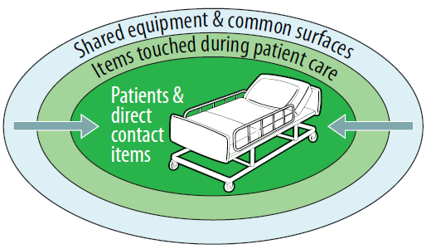

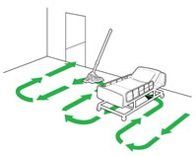

Cleaning and Disinfecting
Workflow should move from clean to dirty when cleaning.
  Avoid contaminating the cloth.
  Clean the resident bathroom after room cleaning.
  Change mop heads frequently, launder daily
  Do not ‘double-dip’ the cloth in the bucket, change it frequently
x 2
Systematic Workflow
Cleaner to Dirtier
No ‘double-dip’
Notes:
Reference:
Ontario Agency for Health Protection and Promotion (Public Health Ontario). Key Elements of Environmental Cleaning in Healthcare Settings. Toronto, ON: Queen’s Printer for Ontario; July 16, 2021. Retrieved from: https://www.publichealthontario.ca/-/media/documents/ncov/ipac/2020/10/factsheet-covid-19-environmental-cleaning-hcs.pdf
Ontario Agency for Health Protection and Promotion (Public Health Ontario), Provincial Infectious Diseases Advisory Committee. Best practices for environmental cleaning for prevention and control of infections in all health care settings. 3rd ed. Toronto, ON: Queen’s Printer for Ontario; 2018. Retrieved from: https://www.publichealthontario.ca/-/media/documents/b/2018/bp-environmental-cleaning.pdf
Images from CDC. (April, 2020). Environmental Cleaning Procedures. Retrieved from: https://www.cdc.gov/hai/prevent/resource-limited/cleaning-procedures.html
When cleaning, you should assess the work area and workflow to move from clean to dirty areas. One should not go back and forth between dirty and clean as this will contaminate clean areas. It is best minimize clutter, note visibly soiled areas and generally work from high to low, and outside to inside the client’s space (2m or 6ft). The area the client spends majority of their time in will be the most highly contaminated. Always do the resident bathroom at the end after cleaning the room as the bathroom is considered the most contaminated space.
If using a cloth and bucket, soak the cloth in the disinfectant in the bucket just prior to using. Do not put the cloth back in the bucket after use on the surface or equipment, but instead put in a separate container for disposal or laundry. If the same cloth goes back into the bucket after being used on a surface, it may contaminate and/or dilute the solution. Always ensure the surface that is being disinfected stays wet for the appropriate contact time. Also consider changing your cloth if you encounter visible soiling or contamination to avoid spreading it around the environment. If you are using a cloth that becomes dry, discard and use a new saturated cloth.

Slide 45



Cleaning and Disinfecting
Develop a schedule for cleaning and disinfecting
High-touch surfaces and items require more frequent cleaning and disinfection.
  Examples- doorknobs, light switches, hand rails, phones
Click here to check out our Cleaning & Disinfection tip sheet
Notes:
Reference:
Ontario Agency for Health Protection and Promotion (Public Health Ontario), Provincial Infectious Diseases Advisory Committee. Best practices for environmental cleaning for prevention and control of infections in all health care settings. 3rd ed. Toronto, ON: Queen’s Printer for Ontario; 2018. Retrieved from: https://www.publichealthontario.ca/-/media/documents/b/2018/bp-environmental-cleaning.pdf.
The frequency of cleaning depends on the surface and items. Some surfaces and items require more frequent cleaning and disinfection. High-touch surfaces have more frequent hand contact compared to low-touch areas that have minimal hand contact and are more likely to have microorganisms on them. High-touch surfaces are to be cleaned more frequently and even more so during an outbreak.
Once you understand how pathogens are transmitted, how and when and what to clean, and how to implement routine practices, it’s important to put it all together into a sensible workflow. Ensuring IPAC measures are integrated into the regular workflow of the workplace is the best way to mitigate the risk of transmitting infections.

Slide 46
Enhanced Cleaning
Additional cleaning of client spaces should be considered if they are on isolation or additional precautions.
High touch surfaces in the client environment should be cleaned more frequently
Shared equipment, items, toys must dedicated or able to be disinfected between use
Notes:
Reference:
Ontario Agency for Health Protection and Promotion, Provincial Infectious Diseases Advisory Committee. Routine Practices and Additional Precautions in All Health Care Settings. 3rd edition. Toronto, ON: Queen’s Printer for Ontario; November 2012. Retrieved from: https://www.publichealthontario.ca/-/media/documents/B/2012/bp-rpap-healthcare-settings.pdf
Additional cleaning of client space should be considered to decrease germs in the environment
High touch surfaces in the patient environment should be cleaned more frequently (multiple times daily. Ensure the product you use has claims against the organism you are concerned about).
Shared equipment, items, toys must be dedicated or cleaned and disinfected between clients
HJ: Need to stress cleaning and proper use of equipment is not just an issue when AP are in place….this is also an important concept of RP. · Suggest….while environmental cleaning is an important aspect of RP - special environmental cleaning may be required if AP are in place e.g. sporicidal agent if CDI is suspected or confirmed
· Again RP –emphasis high touch surfaces, and performed clean to dirty

Slide 47

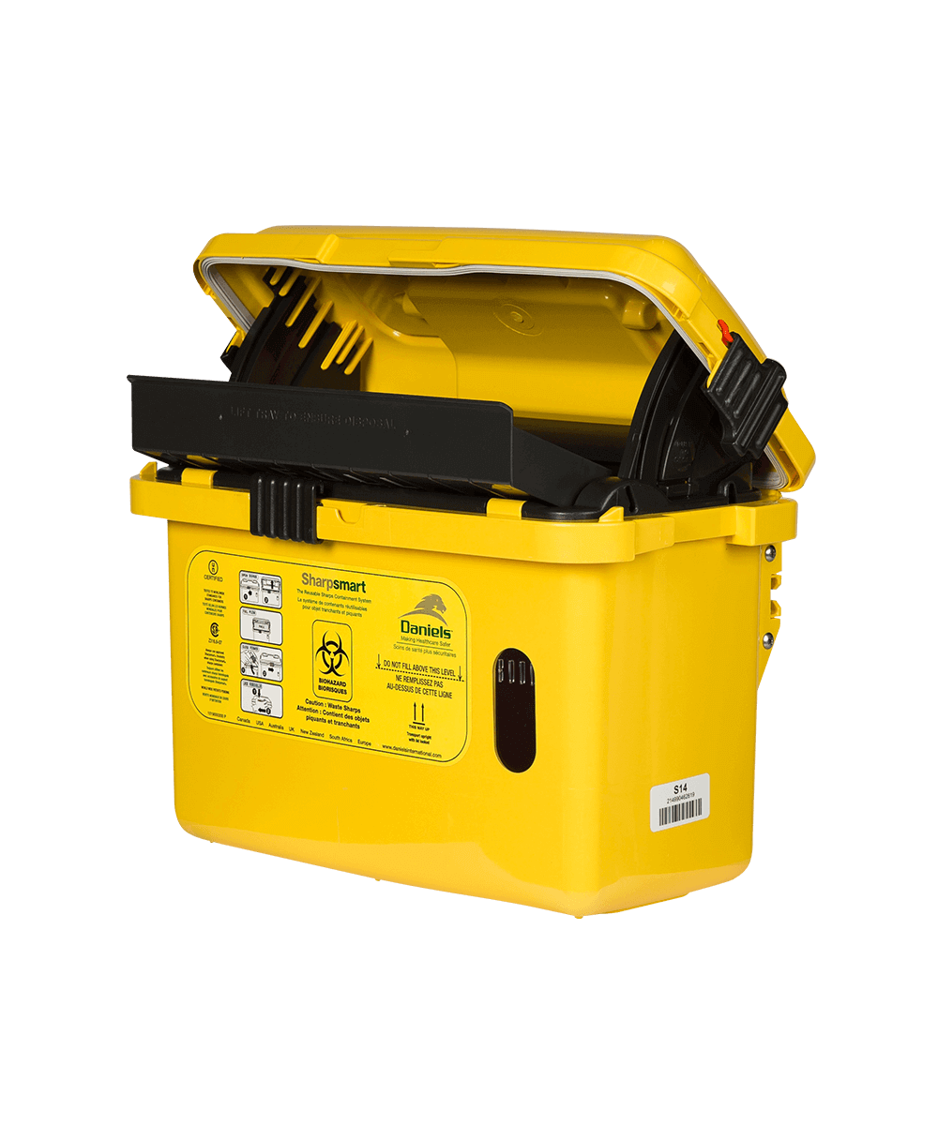
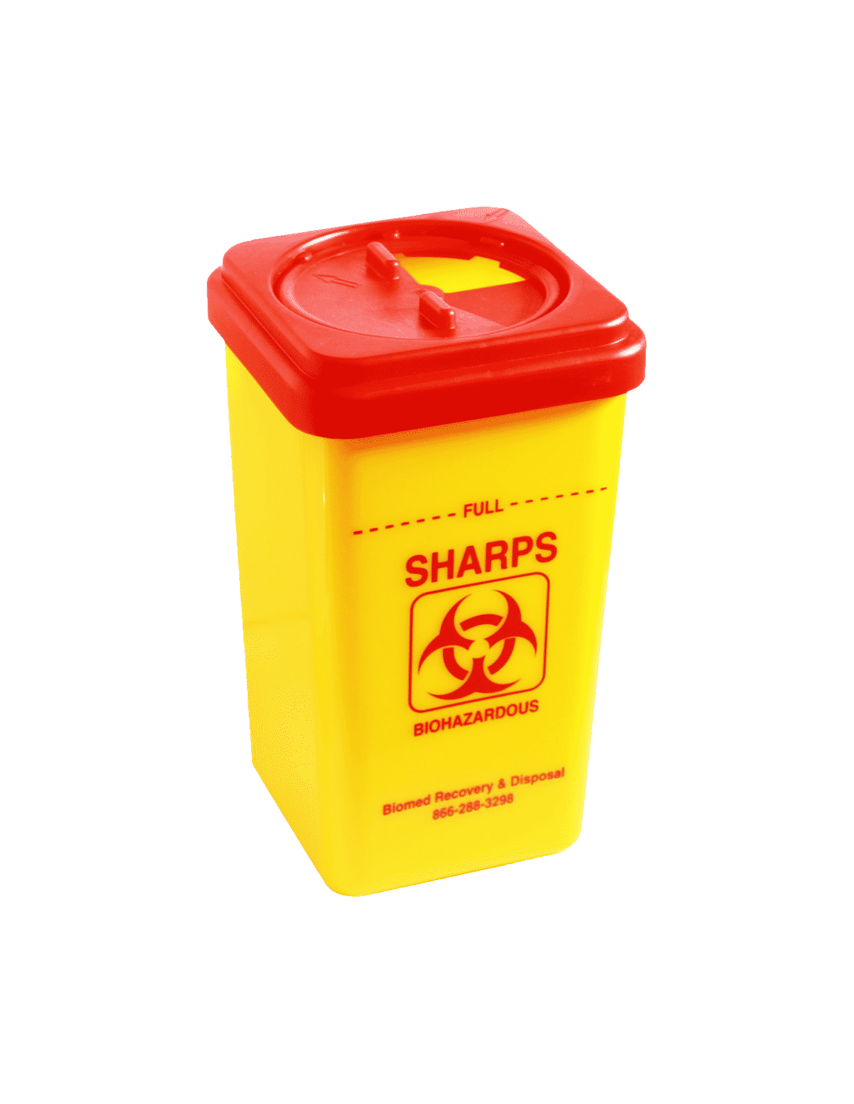
Sharps Safety
Sharps are to be discarded in an approved sharps container.
  Never re-cap or re-use a needle.
Report all incidents of blood or body fluid exposure to the employer and seek medical attention.
Be aware of the organizational sharps policy for safe handling and disposal.
Notes:
Reference - Ontario Agency for Health Protection and Promotion (Public Health Ontario). Key Elements of Environmental Cleaning in Healthcare Settings. Toronto, ON: Queen’s Printer for Ontario; July 16, 2021. Retrieved from: Key Elements of Environmental Cleaning in Healthcare Settings (publichealthontario.ca)
Staff should be aware regarding the different types of waste (sharps, general and biomedical) and how to safely handle and dispose. Biomedical waste and sharps requires special handling and disposal but general waste such as general washroom waste or discarded PPE does not require special handling and disposal. Sharps containers are designated, puncture-resistant, leak proof containers that are intended for the disposal of sharps. Ensure the sharps container is only filled up to the fill line and that it is not left to overflow. Be aware of the organizational policies surrounding the safe handling and disposal of sharps. If a random sharp is encountered in the premises; report it to your employer to ensure safe handling and disposal. All sharps injuries or exposure to blood or body fluid need to be reported to your employer and the appropriate medical attention sought.

Slide 48
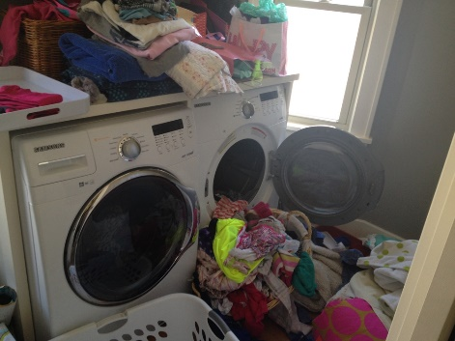
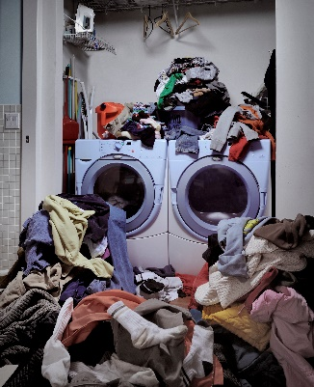
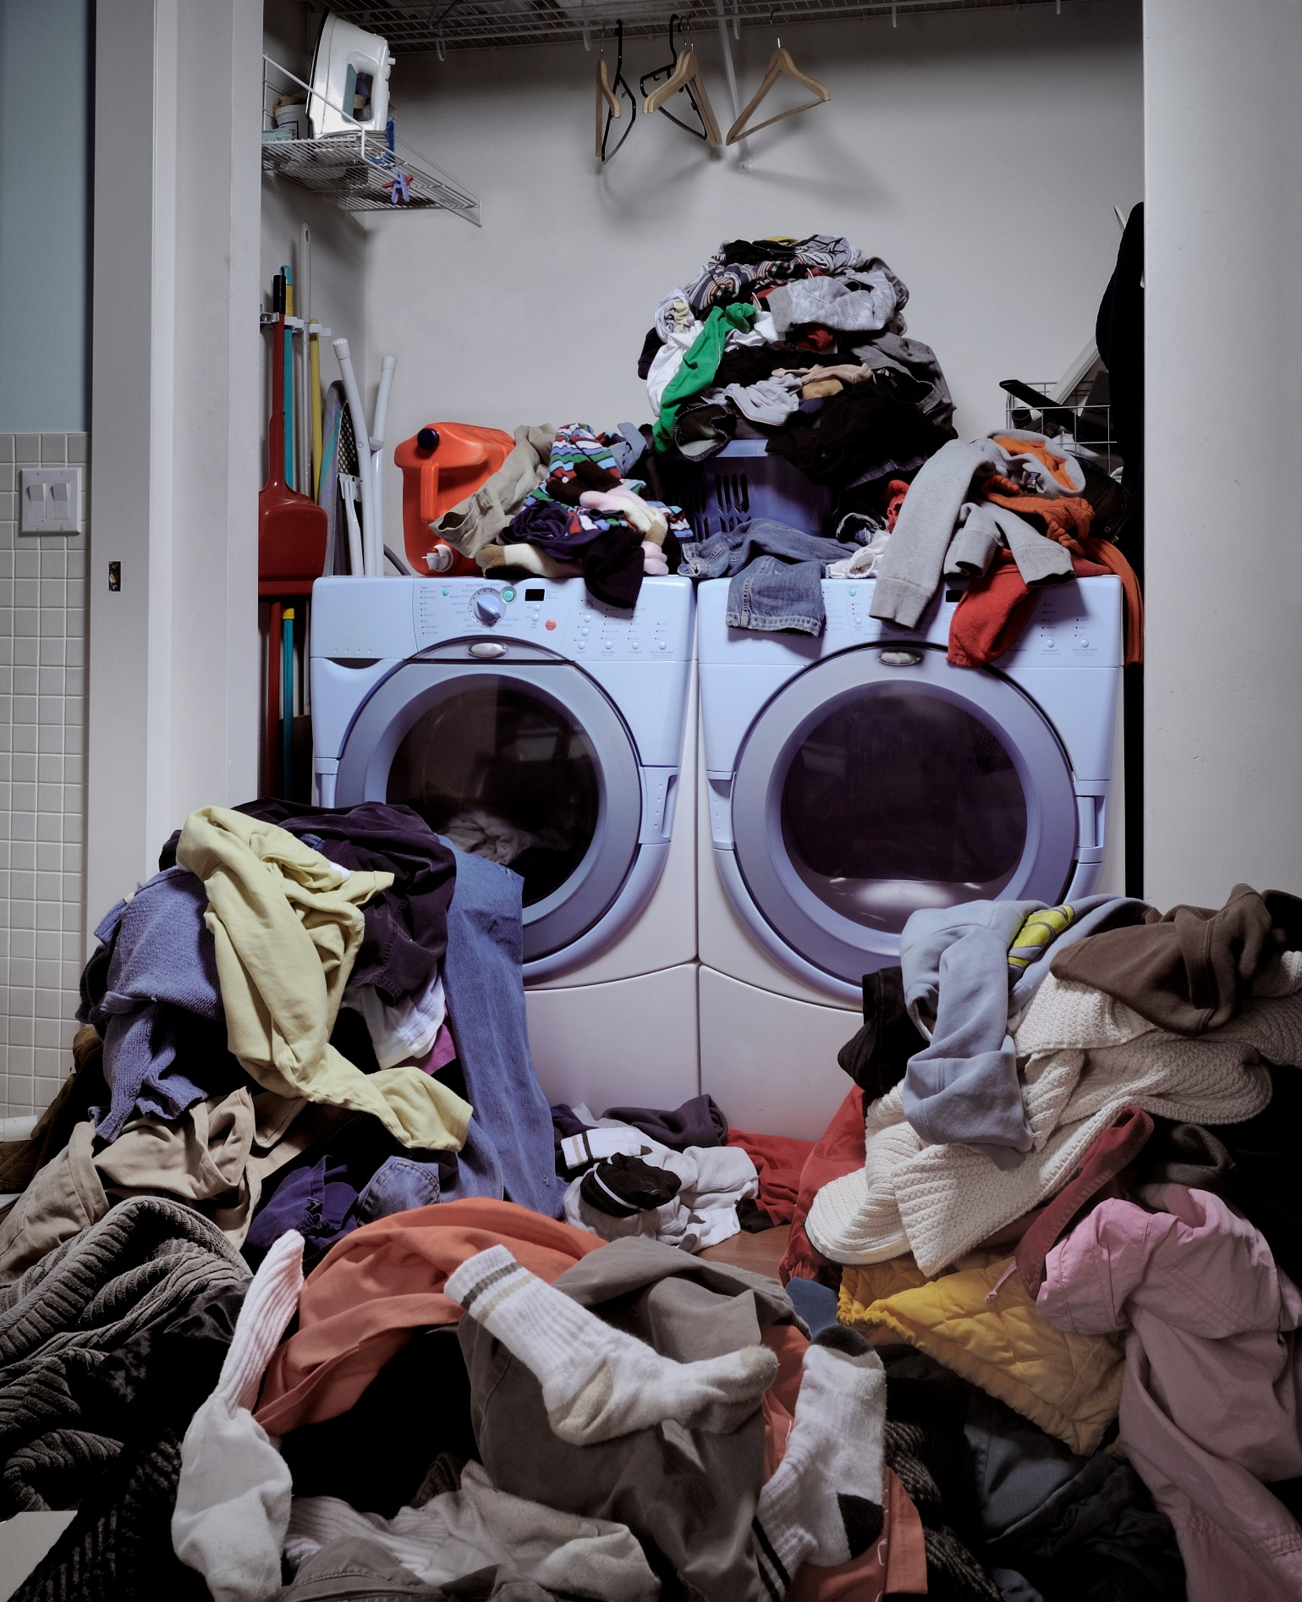
Laundry
Outbreaks from bacteria and fungus can occur due to improper washing, storage and transportation of clean items.
Staff have been exposed to harmful organisms that have been spread by not handling laundry properly.
Due to:
Not following routine practices, and
Improper sorting, transporting and storage of laundry
Notes:
Reference:
Ontario Agency for Health Protection and Promotion (Public Health Ontario), Provincial Infectious Diseases Advisory Committee. Best practices for environmental cleaning for prevention and control of infections in all health care settings. 3rd ed. Toronto, ON: Queen’s Printer for Ontario; 2018. Retrieved from: https://www.publichealthontario.ca/-/media/documents/b/2018/bp-environmental-cleaning.pdf
It is rare, but possible for outbreaks of bacteria and fungus to occur with improper washing, drying, post-cleaning transportation, and improper storage of clean items.
Staff have been exposed to harmful organisms that have been aerosolized by shaking or mishandling laundry, not following routine practices, and
Improperly sorting, transporting and storage of laundry items.
Notes: https://www.publichealthontario.ca/-/media/documents/b/2018/bp-environmental-cleaning.pdf?sc_lang=en

Slide 49
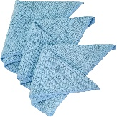



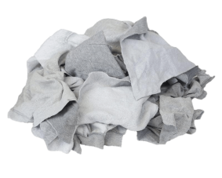
C. Difficile and Laundry
An outbreak of C. Diff was linked to improper cleaning of mop heads
Change mop head after each client room
Launder or dispose of used mop heads daily
Separate personal client items from cleaning laundry
  Ex. Mop heads and cleaning cloths separate from clothing
Launder separately
Launder separately
Notes:
Reference:
Ontario Agency for Health Protection and Promotion (Public Health Ontario), Provincial Infectious Diseases Advisory Committee. Best practices for environmental cleaning for prevention and control of infections in all health care settings. 3rd ed. Toronto, ON: Queen’s Printer for Ontario; 2018. Retrieved from: https://www.publichealthontario.ca/-/media/documents/b/2018/bp-environmental-cleaning.pdf

Slide 50
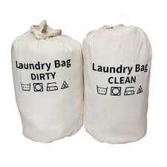
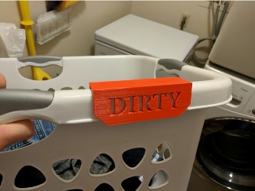
Laundry TIPS
Launder according to manufacturers direction for detergent and the machine. Hot water is preferred.
Remove solid body fluids into a toilet before laundering (e.g., feces, vomit)
Do NOT shake dirty laundry
Use dedicated carts or bins for transporting both clean and dirty laundry separately
Store clean laundry in a way that limits contamination
  In a closed cupboard, drawers and away from dirty areas or items
Watch for sharps! Sharp should not be in laundry, but be careful and have a sharps container in the laundry area in case a mistake is made. Report any sharps found in laundry
Notes:
Reference:
Ontario Agency for Health Protection and Promotion (Public Health Ontario), Provincial Infectious Diseases Advisory Committee. Best practices for environmental cleaning for prevention and control of infections in all health care settings. 3rd ed. Toronto, ON: Queen’s Printer for Ontario; 2018. Retrieved from: https://www.publichealthontario.ca/-/media/documents/b/2018/bp-environmental-cleaning.pdf
launder according to manufacturers direction for detergent and the machine (temperature, length of cycle, how much laundry goes in the machine, etc.) – Generally hot water is preferred.
Do NOT shake dirty laundry into the machine
Watch for sharps (they should not be in laundry, but be cautious and have a sharps container in the laundry area in case a mistake is made. Report any sharps found in laundry)
Use dedicated carts/bins for laundry transport- only transport clean laundry on clean carts/bins. Make sure clean laundry is stored in a way that limits the risk of contamination and transmission of organisms. (e.g. do not store clean laundry in the bathroom, or in high traffic areas)

Slide 51
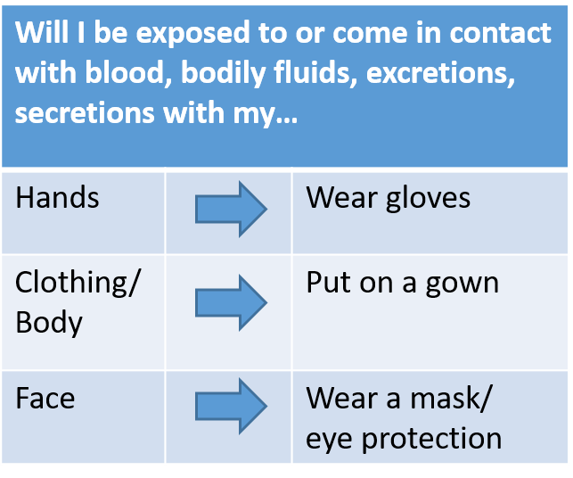
Soiled Laundry
All linen that is soiled with blood, body fluids should be handled using the same precautions, regardless of source or health care setting.
Routine Practices for handling and laundering are sufficient, regardless of the source of the linen. Special laundry handling for clients on Additional Precautions is not routinely required, use your risk assessment.
Notes:
Reference:
Ontario Agency for Health Protection and Promotion (Public Health Ontario), Provincial Infectious Diseases Advisory Committee. Best practices for environmental cleaning for prevention and control of infections in all health care settings. 3rd ed. Toronto, ON: Queen’s Printer for Ontario; 2018. Retrieved from: https://www.publichealthontario.ca/-/media/documents/b/2018/bp-environmental-cleaning.pdf
All linen that is soiled with blood, body fluids, secretions or excretions should be handled using the same precautions, regardless of source or health care setting.
Routine practices for handling and laundering are sufficient, regardless of the source of the linen. Special laundry handling for clients on Additional Precautions is not routinely required.
This is because routine practices address the risk to the worker and provide them with protection against these risks

Slide 52
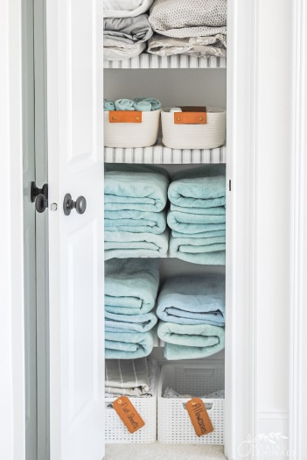
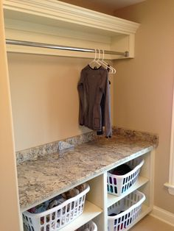
Clean Linen
Pack, transport, store, and sort in a manner that prevents unnecessary touching and contamination
Each facility should have a designated area (e.g., dedicated closet, clean supply room) for sorting, folding and storing clean linen.
Notes:
Reference:
Ontario Agency for Health Protection and Promotion (Public Health Ontario), Provincial Infectious Diseases Advisory Committee. Best practices for environmental cleaning for prevention and control of infections in all health care settings. 3rd ed. Toronto, ON: Queen’s Printer for Ontario; 2018. Retrieved from: https://www.publichealthontario.ca/-/media/documents/b/2018/bp-environmental-cleaning.pdf
Pack, transport, store, and sort in a manner that prevents unnecessary touching and contamination
Each facility should have a designated area (e.g., dedicated closet, clean supply room) for sorting and storing clean linen.

Slide 53
Administrative Controls
Administrative Controls are measures that the administration of an organization puts into place to help protect staff and clients. These can include:
  Policies & Procedures
  Training & Education (clients & staff)
  Immunization requirements
  IPAC compliance audits & feedback
  Healthy workplace initiatives
Notes:
References:
Ontario Agency for Health Protection and Promotion, Provincial Infectious Diseases Advisory Committee. Routine Practices and Additional Precautions in All Health Care Settings. 3rd edition. Toronto, ON: Queen’s Printer for Ontario; November 2012. Retrieved from: https://www.publichealthontario.ca/-/media/documents/B/2012/bp-rpap-healthcare-settings.pdf
Administrative Controls are measures to reduce the risk of transmission through the implementation of policies, procedures, training and education. Examples of administrative controls, active and passive screening signage, restricted visitor policies, hand hygiene, cleaning and immunization policies. In addition, administrative controls include policies regarding restricting entrances, cohorting of staff and patients and designated centres for screening or treating patients.
It is important that all staff are aware of the policies and procedures related to their type of work, and that they have all the required training and education related to their job.

Slide 54
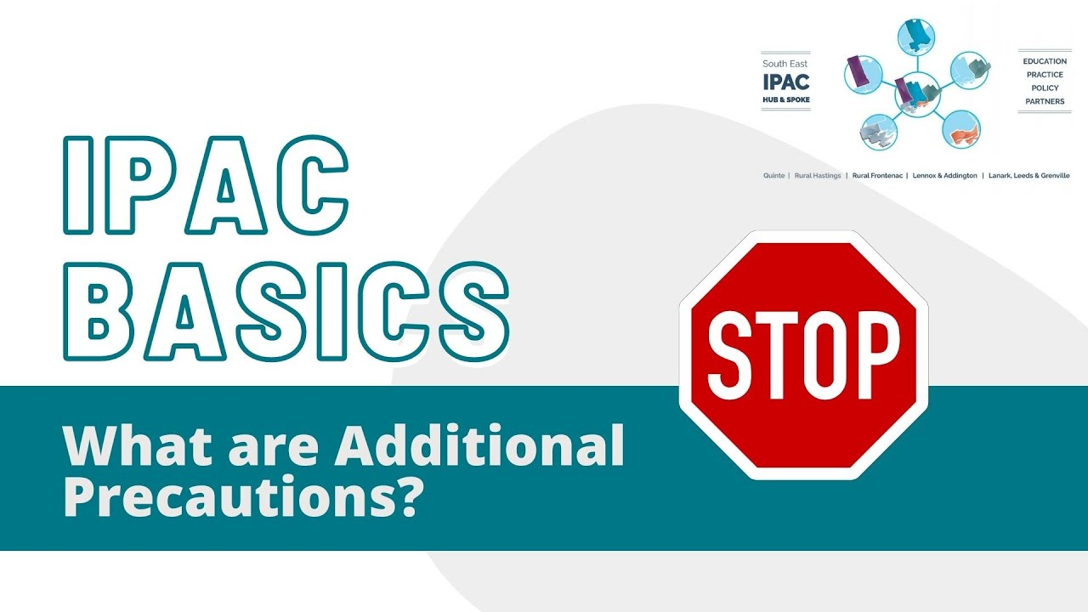
Click the image to watch the video or the link here: https://youtu.be/KSxFLSz1Bu8
Notes:
Reference:
Ontario Agency for Health Protection and Promotion, Provincial Infectious Diseases Advisory Committee. Routine Practices and Additional Precautions in All Health Care Settings. 3rd edition. Toronto, ON: Queen’s Printer for Ontario; November 2012. Retrieved from: https://www.publichealthontario.ca/-/media/documents/B/2012/bp-rpap-healthcare-settings.pdf
Video link: https://youtu.be/KSxFLSz1Bu8
In addition to Routine Practices, Additional Precautions are necessary for known or suspected pathogens or clinical presentations. Additional precautions will be determined by the physician, nurse or most responsible person. These precautions are based on how the pathogen or germ is spread, and are broken into a few categories:
CONTACT: Direct contact from person to person (i.e., by hands or bodily fluids) or by indirect contact through an inanimate object or the environment (i.e., a stethoscope, pulse oximeter, ultra-sound probe, or gel). Examples of contact-spread disease include antibiotic-resistant organisms such as Methicillin-resistant Staphylococcus aureus (MRSA), scabies, lice, and shingles.
DROPLET: Via large droplets, generally respiratory secretions (> 5 μm) that can travel 2m and enter another person’s respiratory tract or mucous membranes, or land in the environment and could be transmitted at a later time. Examples of infections spread by the droplet route include influenza and pertussis.
AIRBORNE: Via small respirable particles (≤ 5 μm) that can remain suspended in the air for a period of time. Examples of airborne diseases include pulmonary tuberculosis, measles, and chickenpox.
These additional precautions can be combined e.g. Contact/Droplet or Contact/Airborne.

Slide 55
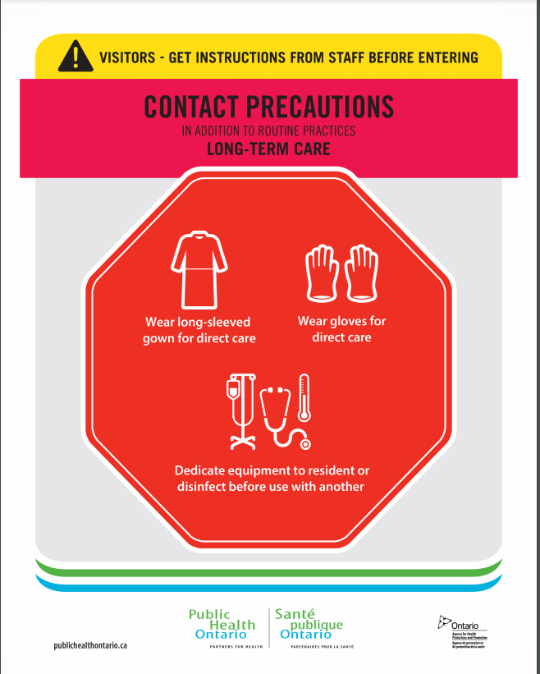
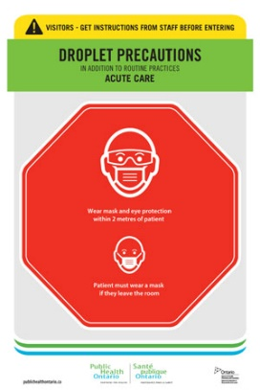

Different Types of Isolation Precautions
“Additional Precautions” are based on Mode of Transmission
There are different types of additional precautions which are based on the way the germs spread. They are:
  Contact precautions
  Droplet precautions
  Airborne precautions
Additional precautions can be used in combination
  Droplet & Contact
Additional precautions still require a point of care risk assessment and
are ALWAYS used in ADDITION to Routine Practices.
Notes:
Reference:
Ontario Agency for Health Protection and Promotion, Provincial Infectious Diseases Advisory Committee. Routine Practices and Additional Precautions in All Health Care Settings. 3rd edition. Toronto, ON: Queen’s Printer for Ontario; November 2012. Retrieved from: https://www.publichealthontario.ca/-/media/documents/B/2012/bp-rpap-healthcare-settings.pdf
The additional precautions indicated are now the minimum requirement, in addition to routine practices, for entering the client’s bed space or room. You must remember to continue to use your PCRA as you may still require additional PPE + additional precautions (e.g., client on contact precautions, you are about to enter the room and hear the individual coughing – based on your PCRA you determine a risk of splash/spray and add a mask/eye protection for that interaction in addition to the required contact precautions).

Slide 56
Using Signs to Communicate Precautions
A sign that lists the required precautions should be posted at the entrance to the room or bed space.
These precautions are the minimum requirements for entry
Click here to see Public Health Ontario’s additional precaution signage
Notes:
References:
Ontario Agency for Health Protection and Promotion, Provincial Infectious Diseases Advisory Committee. Routine Practices and Additional Precautions in All Health Care Settings. 3rd edition. Toronto, ON: Queen’s Printer for Ontario; November 2012. Retrieved from: https://www.publichealthontario.ca/-/media/documents/B/2012/bp-rpap-healthcare-settings.pdf
Public Health Ontario Additional Precautions Signage and Lanyard Cards. Retrieved from: https://www.publichealthontario.ca/en/health-topics/infection-prevention-control/routine-practices-additional-precautions/additional-precautions-signage
A sign that lists the required precautions should be posted at the entrance to room or bed space to alert anyone entering the room about what minimum precautions are required. If you are unsure of the additional precautions, questioning why the sign was there yesterday and not today - you MUST ask the most responsible person BEFORE you enter to make sure you are working safely and not putting yourself or others at risk. When you work with uncertainty in IPAC you put everyone at risk.

Slide 57
Cohorting
Reduces risk of transmission by controlling movement of clients and/or staff
Client Cohorting
Placing those who are sick or have been exposed together
Using dedicated equipment
New gown & gloves should be worn between each client
Staff Cohorting
Dedicate staff to care only for colonized/infected clients; OR,
Care for those who are not colonized or infected.
Keep staff in specific areas of the facility
Used in addition to client cohorting
If you can’t cohort, you must provide care based on the order of risk
Notes:
References:
Ontario Agency for Health Protection and Promotion (Public Health Ontario). Focus on: cohorting in outbreaks in congregate living settings. Toronto, ON: Queen’s Printer for Ontario; 2020. Retrieved from https://www.publichealthontario.ca/-/media/documents/ncov/cong/2020/06/focus-on-cohorting-outbreaks-congregate-living-settings.pdf?sc_lang=en
Ontario Agency for Health Protection and Promotion, Provincial Infectious Diseases Advisory Committee. Routine Practices and Additional Precautions in All Health Care Settings. 3rd edition. Toronto, ON: Queen’s Printer for Ontario; November 2012. Retrieved from: https://www.publichealthontario.ca/-/media/documents/B/2012/bp-rpap-healthcare-settings.pdf
Cohorting can be used when single rooms are not available or during outbreak situations if multiple client become affected. Cohorting should never compromise infection control practices and Additional Precautions must be applied individually for each client/patient/resident within the cohort – even if they have the same organism in the same room. (e.g., a double room, each bed space is treated as its own single room – PPE changed before going to the other individual – currently with the exception of masks and eye protection).
Resident/Client/Patient:
resident cohorting does not imply that a resident is moved out of his/her room. Rather, those who already share a room or who share a bathroom and who are infected or colonized with the same microorganism may be treated as a cohort.
Placing those who have been exposed together to limit risk of further transmission
Equipment should be dedicated or cleaned between use.
Fresh gown/gloves should be worn between each individual.
Geographical cohorting refers to restricting patients who are infected or colonized with the same microorganism to several rooms along a corridor or an entire clinical unit. Use of this practice can limit transmission by segregating those who are infected or colonized to a specified area away from those who are not
Staff Cohorting:
Dedicated staff to care only for colonized/infected client; OR,
Care for those who are not colonized or infected. (not going between infected/sick and well)
Used in addition to resident/client/patient cohorting
Limits risk of cross-infection and exposures

Slide 58
Order of Risk
Lowers the risk of spreading germs by moving from lower risk to higher risk client interactions.
  E.g. healthy/well to ill clients
If staff are able; complete tasks in client rooms who are not on additional precautions first, then assist clients on additional precautions
  E.g. Provide housekeeping to clients not on additional precautions before clients on additional precautions
Clients not on additional precautions (Routine Practices); then
Clients on isolation or additional precautions
Notes:
Being aware of the risk that is present to you through your point of care risk assessment is extremely important; in addition to this, we also need to be aware of the risk of transmission we create through our everyday work. In general it is best to work from areas of low risk to high risk. The following are some examples:
Complete tasks in client rooms who are not on additional precautions first, then move to other areas.
If a client is unwell, complete tasks in the well client areas first then move to those who are unwell.
Wipe equipment from clean to dirty, not dirty to clean or use multiple wipes/cloths for heavily soiled items
When cleaning a room, clean the bathroom last
Can you think of any other ways to limit risk to others by changing the order of tasks?

Slide 59
What is Surveillance
“Surveillance is the systematic, ongoing collection, collation and analysis of data with timely dissemination of information to those who require this information in order to take action”
Surveillance = watching for signs and symptoms that are new or acutely worse than the resident’s baseline , which could be clinically important or signs of an infection.
Surveillance involves:
Observation – done by all staff
Record & Analyze – health care staff (e.g., Nurse, most responsible person).
If a client seems different from their baseline you should let the most responsible person know so they can assess and take any required action.
Notes:
Reference:
Infection Prevention and Control Canada (IPAC Canada). (2017). Surveillance Definitions of Infections in Canadian Long Term Care Facilities. Retrieved from: https://www.patientsafetyinstitute.ca/en/About/PatientSafetyForwardWith4/Documents/Canadian%20LTC%20Surveillance%20Definitions.pdf
Ontario Agency for Health Protection and Promotion (Public Health Ontario), Provincial Infectious Diseases Advisory Committee. Best practices for surveillance of health care-associated infections in patient and resident populations. 3 rd ed. Toronto, ON: Queen’s Printer for Ontario; 2014. Retrieved from: https://www.publichealthontario.ca/-/media/documents/b/2014/bp-hai-surveillance.pdf?sc_lang=en
Observation is a key component of surveillance, observations must be recorded and then analyzed for trends in illness. All staff, even non-clinical staff, may have direct exposure to client; your familiarity with them and their baseline can be the starting point for surveillance.

Slide 60
Purpose of Surveillance
Observing resident health can catch infections before they spread
Is the new symptom due to:
Declining health
Medication reaction
Infection or disease
If a client has a contagious illness or infection, early identification is key to limiting the spread of germs
Notes:
Reference:
Henning, Kelly. (September, 2004). Overview of Syndromic Surveillance: What is Syndromic Surveillance? Retreived from: https://www.cdc.gov/mmwr/preview/mmwrhtml/su5301a3.htm
Ontario Agency for Health Protection and Promotion (Public Health Ontario), Provincial Infectious Diseases Advisory Committee. Best practices for surveillance of health care-associated infections in patient and resident populations. 3 rd ed. Toronto, ON: Queen’s Printer for Ontario; 2014. Retrieved from: https://www.publichealthontario.ca/-/media/documents/b/2014/bp-hai-surveillance.pdf?sc_lang=en
In your setting you may have direct exposure the patients/residents and know what their baseline is. If you work in dietary and notice a resident has started eating less, or complaining of a sore stomach, or if you are environmental cleaning and you notice a resident is experiencing a cough,
Who should you tell in your organization?

Slide 61



What is the difference between…
Endemic: Constant presence and/or usual prevalence of a disease/infectious agent in a particular region.
Epidemic: Increase in the number of cases of a disease above what is normally expected in a particular population
Outbreak: Same definition as epidemic but for a limited geographic area.
Pandemic: An epidemic that has spread over several countries or continents.
Endemic
Epidemic
Pandemic
Notes:
Reference - https://www.cdc.gov/csels/dsepd/ss1978/lesson1/section11.html
Diseases can be present in populations in varying amounts. Many diseases are endemic in a population, meaning it always stays at a particular level in certain geographical areas (e.g., chickenpox). If the number increases above what is normally expected then we would refer to that as an epidemic. Outbreaks can also occur but those are usually to a limited geographic area; for example there could be an influenza outbreak in a care facility or an outbreak of a sexually transmitted infection in a city. A pandemic is when the disease is above normal expected levels has spread over several countries or continents.
When any disease is above the expected rates or is a significant threat to public health there could be extra precaution measures that may be required to control and/or contain the spread of these germs. During an outbreak of a sexually transmitted infection (STI) public health notices, testing, and sexual health education would be increased. During the COVID-19 pandemic there were extra public health measures which included: universal masking, physical distancing, gathering size restrictions and more, which were all put in place to help control the spread of COVID-19, as well as other respiratory germs.

Slide 62
‘Swiss Cheese’ Summary
Organizational Responsibility
Barriers, point of care
ABHR, sharps, PPE
Audits, reviewing
compliance
Staying home when sick
Clinical management
processes
Cleaning shared equipment
Cleaning the environment
Point of Care Risk Assessment
Germs
Transmission
Proper use of PPE
Hand Hygiene
Respiratory Etiquette
Avoid touching your face
Following policies
and procedures
Policy & procedure
Development
IPAC training
and education
Surveillance,
signs & symptoms of illness
Elimination, isolation
Cohorting protocols
HVAC
The ‘Swiss cheese’ model recognizes that no single intervention or control is perfect at preventing transmission. Multiple layers of interventions and controls helps to improve successful outcomes, limiting spread of germs. The holes are problems and opportunities for improvement within each control measure.
Personal Responsibility
Notes:
References:
Ontario Agency for Health Protection and Promotion, Provincial Infectious Diseases Advisory Committee. Routine Practices and Additional Precautions in All Health Care Settings. 3rd edition. Toronto, ON: Queen’s Printer for Ontario; November 2012. Retrieved from: https://www.publichealthontario.ca/-/media/documents/B/2012/bp-rpap-healthcare-settings.pdf
Canadian Patient Safety Institute. (August, 2017). The Case for Investing in Patient Safety in Canada. Retrieved from: http://www.patientsafetyinstitute.ca/en/About/Documents/The%20Case%20for%20Investing%20in%20Patient%20Safety.pdf
To help us understand how all of the elements of routine practices work to help limit the spread of germs we will use the ‘Swiss cheese model’. Each slice of cheese represents an intervention or control measure meant to prevent or limit the spread of germs. The holes are weaknesses in these control measures. The hazards (germs, pathogens, infectious organisms) can’t transmit or spread if the control measures are in place are working; however, if the holes line up or there are enough holes, transmission of germs can occur. The image clearly shows some personal and organizational responsibilities that both play parts in limited the spread of germs.
Personal responsibilities include control measures on the right:
Proper use of PPE
Point of care Risk Assessment and awareness of how to prevent infection at the individual level
HH, respiratory etiquette, avoid touching your face, cleaning shared equipment and the environment
S&S of common illnesses
Staying home if you are sick
Being aware of and following organization policy, procedures (administrative controls)
Organization responsibilities include control measures on the left:
Auditing, gathering feedback, reviewing compliance
IPAC awareness, training and education
Developing & reviewing policies, procedures, processes for clinical management and response (administrative controls)
Implementing barriers, point of care ABHR, sharps containers, PPE supplies, managing HVAC (engineering controls)
Elimination & substitution by isolation and cohorting protocols,
Every workplace should strive to create a culture of safety to protect staff and clients. IPAC is embedded at all levels, in all areas of work and everyone has a responsibility. IPAC is everyone’s job and we need to keep our team accountable and make our intention, infection prevention.

Slide 63
Certificate Courses
Other courses for continuing education:
Food Handler Training – Canada Food Safety Training
COVID-19 IPAC Fundamentals Training – Public Health Ontario
IPAC Core Competencies – Public Health Ontario
Environmental Cleaning Courses - ISSA Canada/Canadian Healthcare Housekeepers Association

Slide 64
Questions?
Contact us by email: SEhubintake@kingstonhsc.ca
Visit our website at:
https://kingstonhsc.ca/healthcare-providers/se-ipac-hub-and-spoke

Slide 65
References
Canadian Patient Safety Institute. (August, 2017). The Case for Investing in Patient Safety in Canada. Retrieved from: http://www.patientsafetyinstitute.ca/en/About/Documents/The%20Case%20for%20Investing%20in%20Patient%20Safety.pdf
Centers for Disease Control and Prevention. (September 18, 2016). Infection Control: Table 2. Properties of an ideal disinfectant. Retrieved from: https://www.cdc.gov/infectioncontrol/guidelines/disinfection/tables/table2.html
Henning, Kelly. (September, 2004). Overview of Syndromic Surveillance: What is Syndromic Surveillance? Retreived from: https://www.cdc.gov/mmwr/preview/mmwrhtml/su5301a3.htm
Infection Prevention and Control Canada (IPAC Canada). (2017). Surveillance Definitions of Infections in Canadian Long Term Care Facilities. Retrieved from: https://www.patientsafetyinstitute.ca/en/About/PatientSafetyForwardWith4/Documents/Canadian%20LTC%20Surveillance%20Definitions.pdf
The National Institute for Occupational Safety and Health (NIOSH). (Janurary, 2015). Hierarchy of Controls. Retrieved from: https://www.cdc.gov/niosh/topics/hierarchy/default.html
Ontario Agency for Health Protection and Promotion, Provincial Infectious Diseases Advisory Committee. Routine Practices and Additional Precautions in All Health Care Settings. 3rd edition. Toronto, ON: Queen’s Printer for Ontario; November 2012. Retrieved from: https://www.publichealthontario.ca/-/media/documents/B/2012/bp-rpap-healthcare-settings.pdf
Ontario Agency for Health Protection and Promotion (Public Health Ontario), Provincial Infectious Diseases Advisory Committee. Best practices for surveillance of health care-associated infections in patient and resident populations. 3 rd ed. Toronto, ON: Queen’s Printer for Ontario; 2014. Retrieved from: https://www.publichealthontario.ca/-/media/documents/b/2014/bp-hai-surveillance.pdf?sc_lang=en
Ontario Agency for Health Protection and Promotion (Public Health Ontario). Infection prevention and control for long-term care homes: summary of key principles and best practices. Toronto, ON: Queen’s Printer for Ontario; 2020. Retrieved from: https://www.publichealthontario.ca/-/media/documents/i/2021/ipac-ltch-principles-best-practices.pdf?sc_lang=en

Slide 66
References
Ontario Agency for Health Protection and Promotion (Public Health Ontario). Focus on: cohorting in outbreaks in congregate living settings. Toronto, ON: Queen’s Printer for Ontario; 2020. Retrieved from https://www.publichealthontario.ca/-/media/documents/ncov/cong/2020/06/focus-on-cohorting-outbreaks-congregate-living-settings.pdf?sc_lang=en
Ontario Agency for Health Protection and Promotion (Public Health Ontario), Provincial Infectious Diseases Advisory Committee. Best Practices for Hand Hygiene in All Health Care Settings. 4th ed. Toronto, ON: Queen’s Printer for Ontario; January 2014. Retrieved from: https://www.publichealthontario.ca/-/media/documents/b/2014/bp-hand-hygiene.pdf?la=en
Ontario Agency for Health Protection and Promotion (Public Health Ontario). Key Elements of Environmental Cleaning in Healthcare Settings. Toronto, ON: Queen’s Printer for Ontario; July 16, 2021. Retrieved from: https://www.publichealthontario.ca/-/media/documents/ncov/ipac/2020/10/factsheet-covid-19-environmental-cleaning-hcs.pdf
Public Health Ontario. (July 16, 2021). Key Elements of Environmental Cleaning in Healthcare Settings. Retrieved from: https://www.publichealthontario.ca/-/media/documents/ncov/ipac/2020/10/factsheet-covid-19-environmental-cleaning-hcs.pdf
Public Health Ontario. (July 30, 2021). Cleaning and Disinfection for Public Settings. Retrieved from: https://www.publichealthontario.ca/-/media/documents/ncov/factsheet-covid-19-environmental-cleaning.pdf

